Slide 2
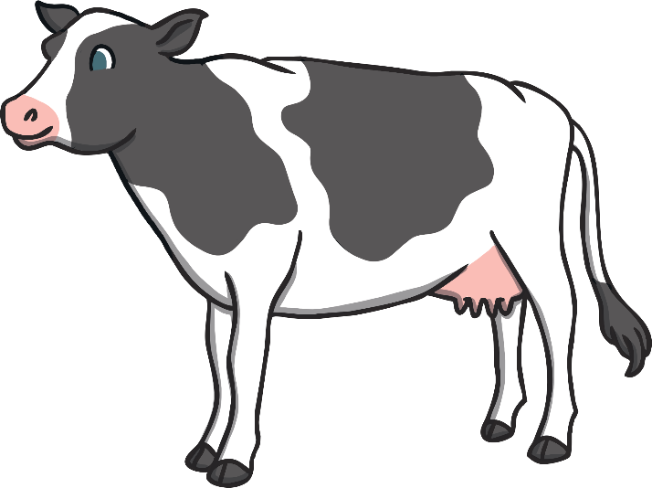
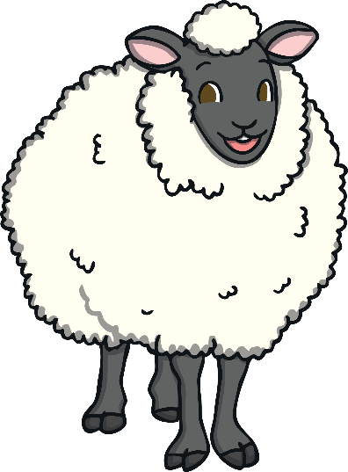
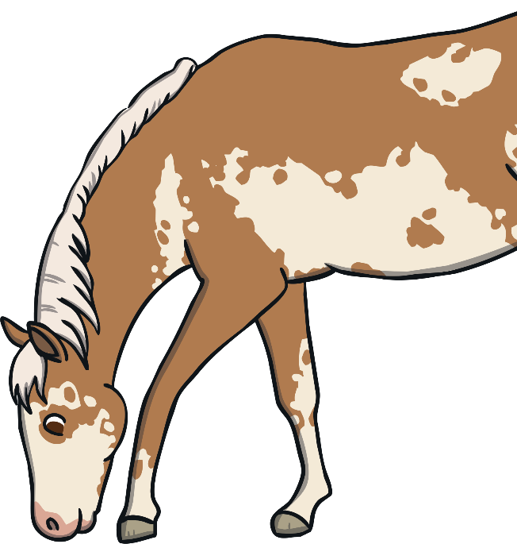
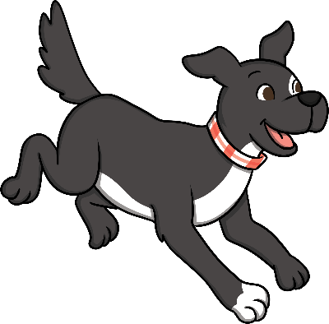
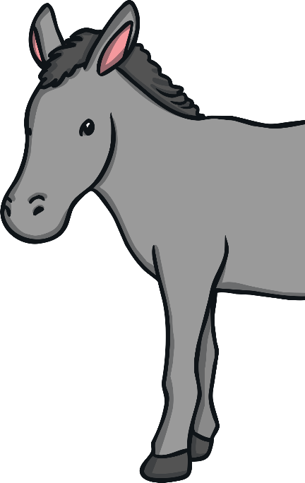
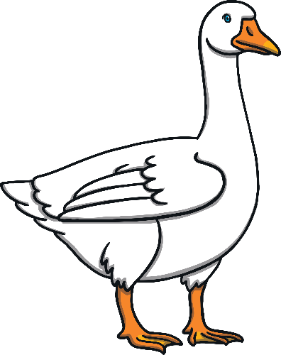
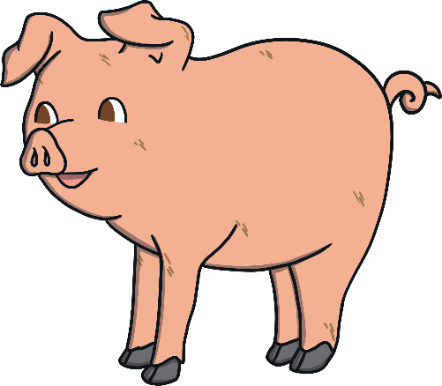
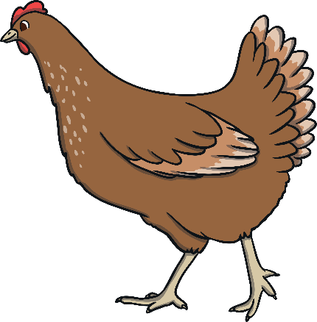
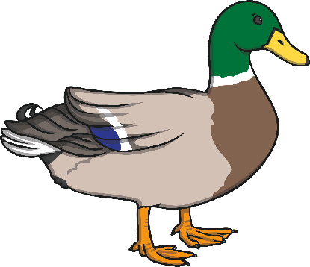
Click on the animals to see where they live on the farm.
Cows
Sheep and sheepdogs
Horses and donkeys
Geese and ducks
Chickens
Pigs

Slide 3
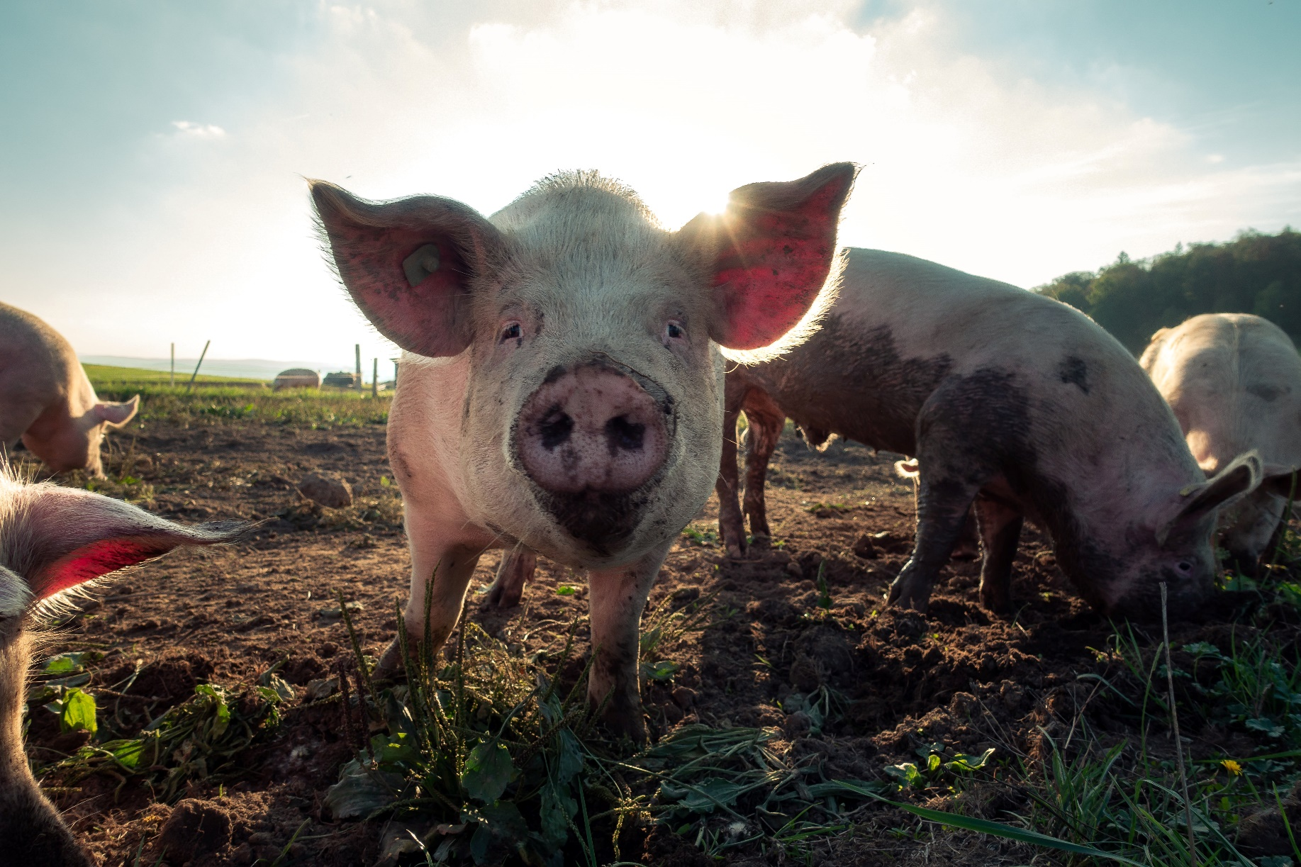
Pigs live in a sty with lots of mud for them to
roll around in for keeping cool in summer.
Back to the Farm

Slide 4
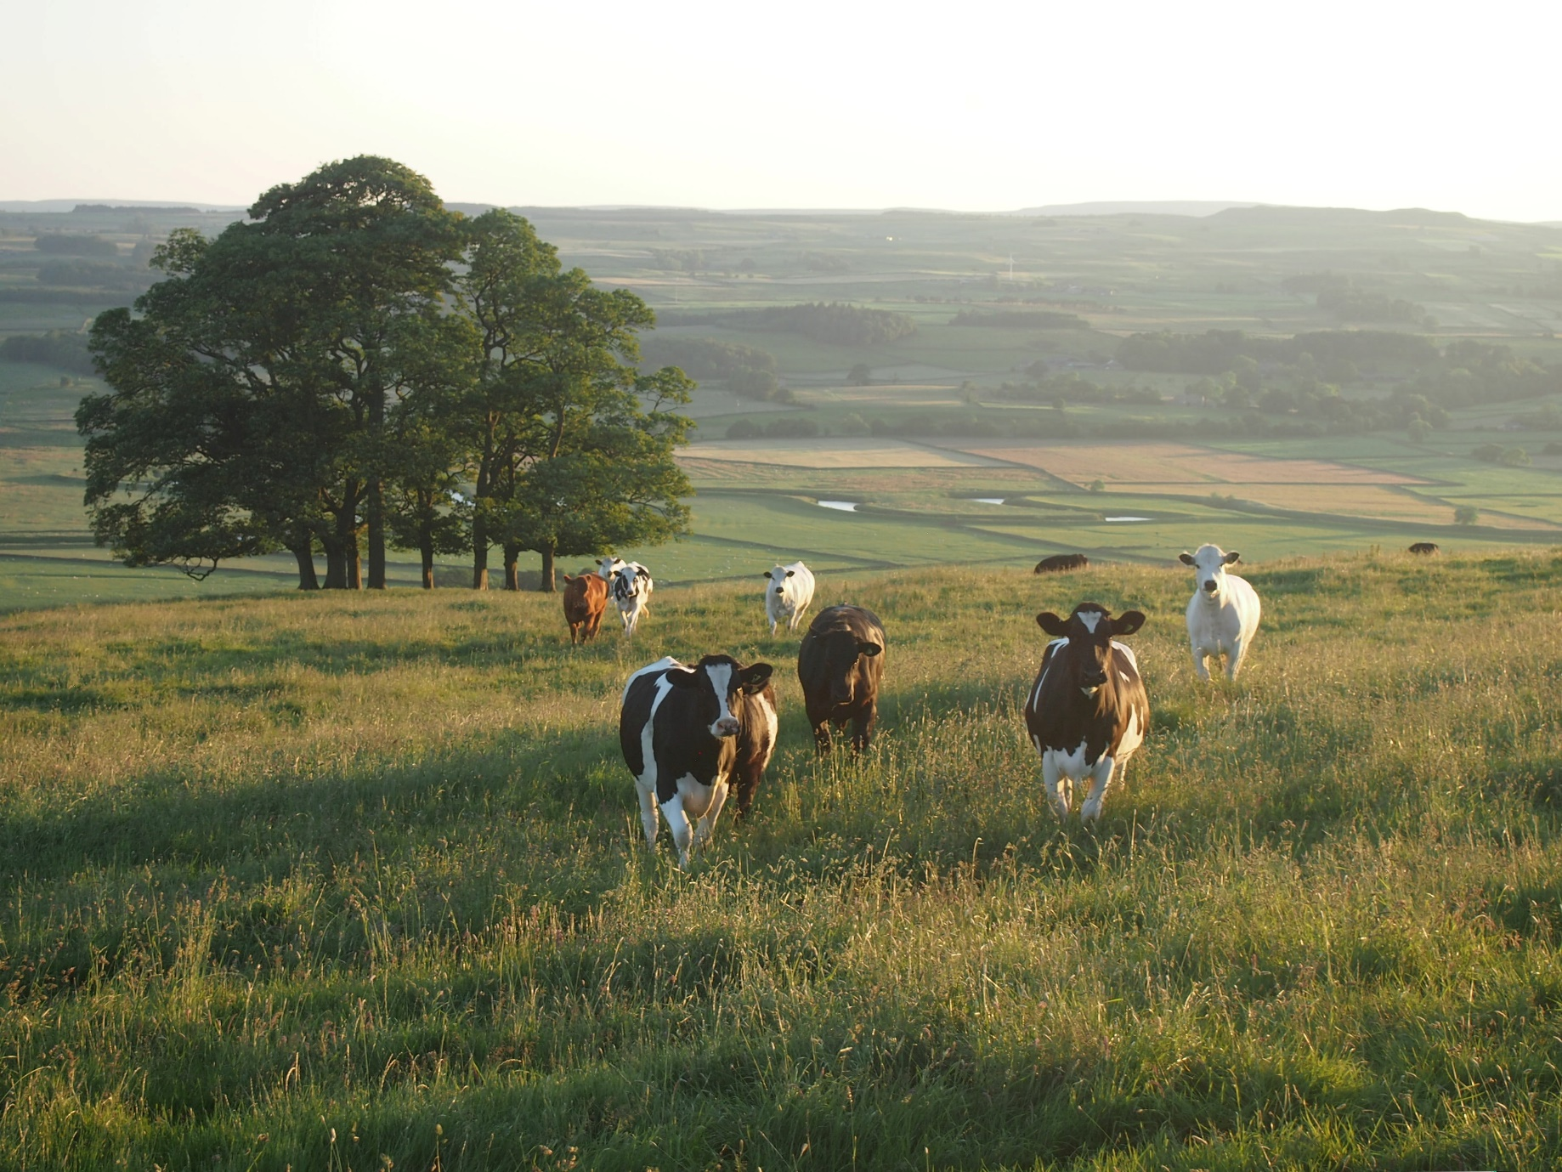
Cows live in fields with plenty of grass for them to feed on.

Slide 5
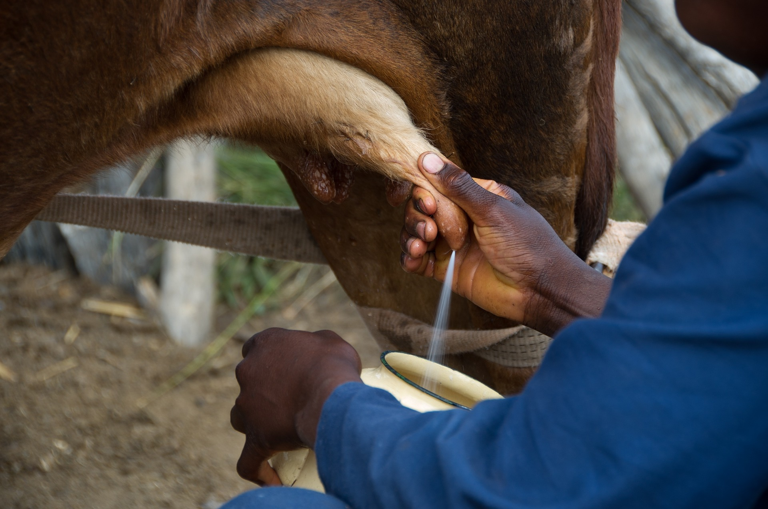
Cows are milked in the barn. The farmer cleans the milk and then it is sent to the shops for people to buy.
Back to the Farm

Slide 6
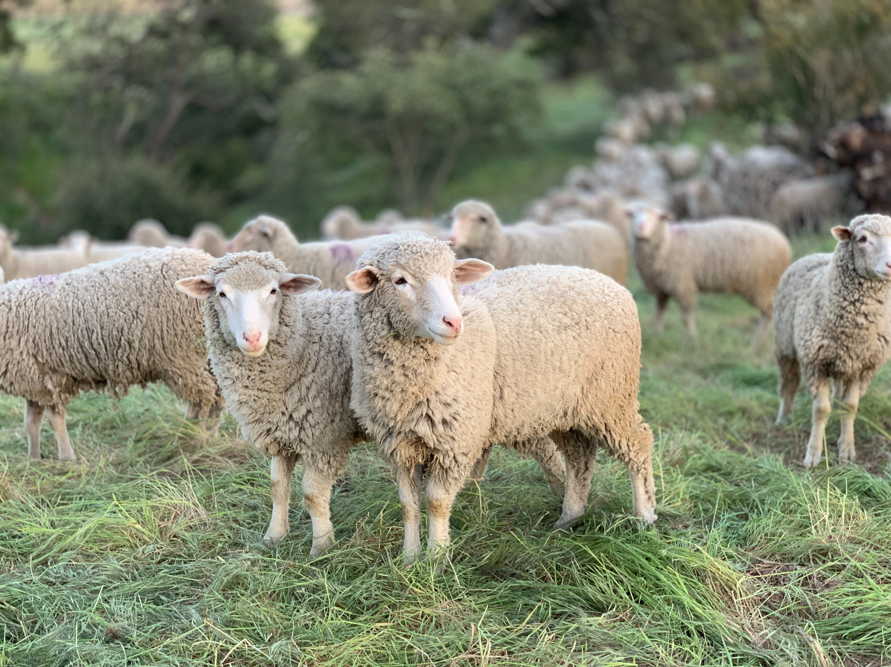
Sheep live outside where they like to eat grass.
They have big woolly coats to keep them warm.
When it is very cold, some sheep stay in a barn.

Slide 7
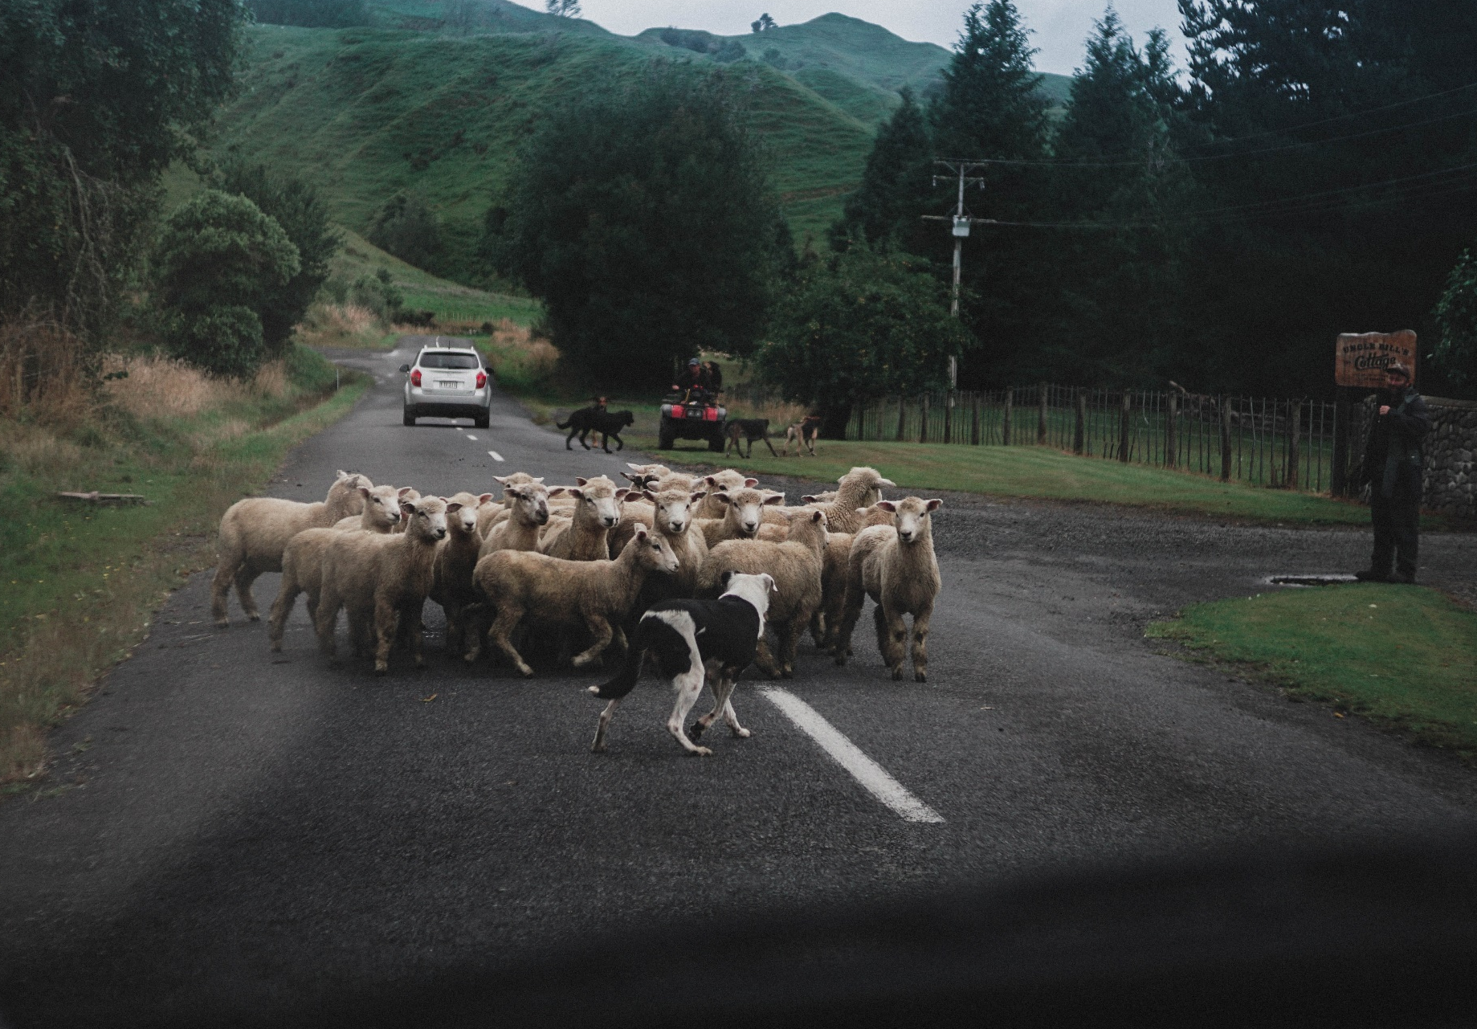
A sheepdog helps to round the sheep up when it
is time for them to come into the barn.

Slide 8
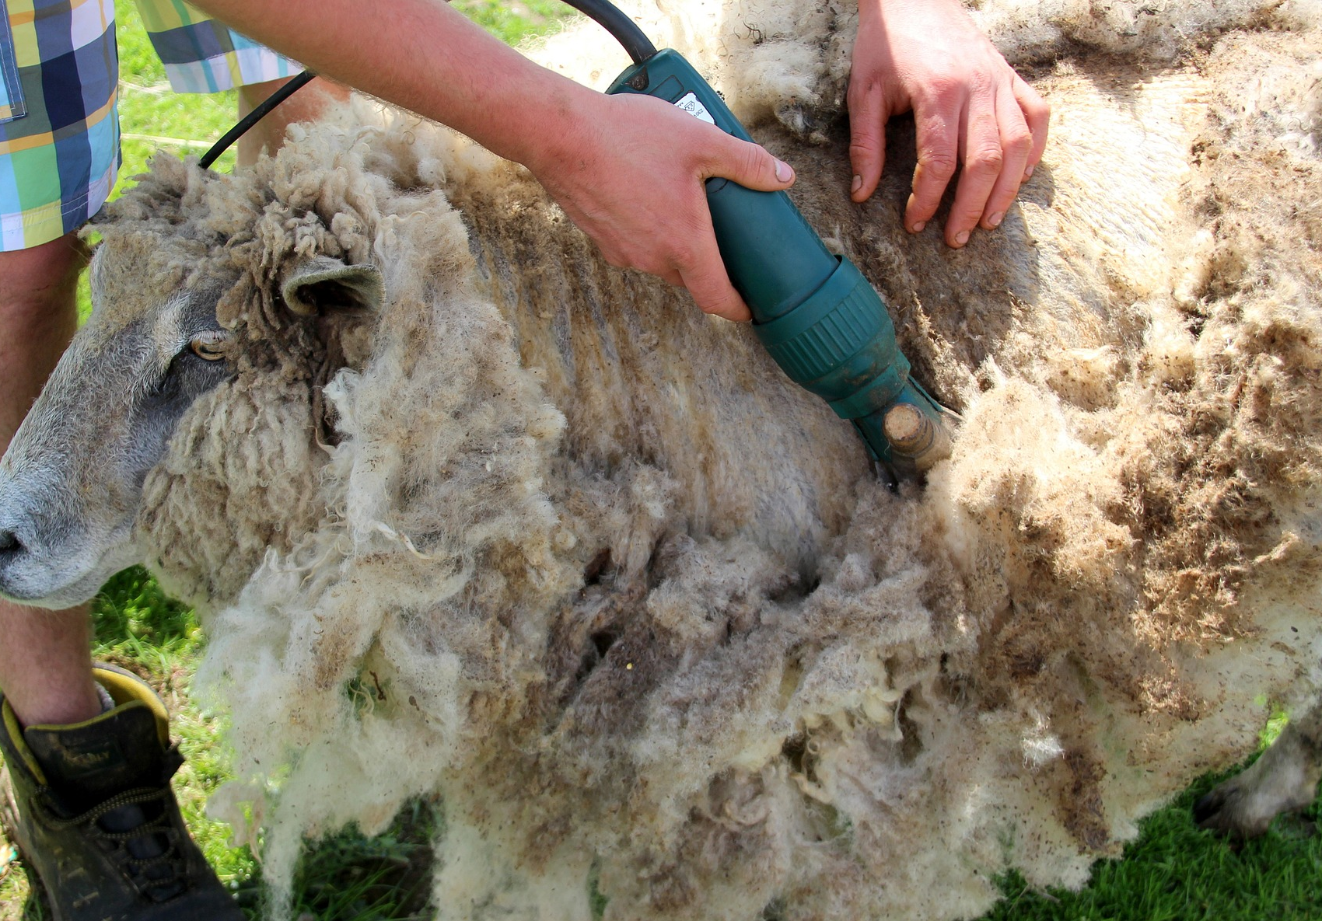
In the summer, the farmers shear the sheep. They shave off their
woolly coats. The wool is used to make clothes, like jumpers.
Back to the Farm

Slide 9
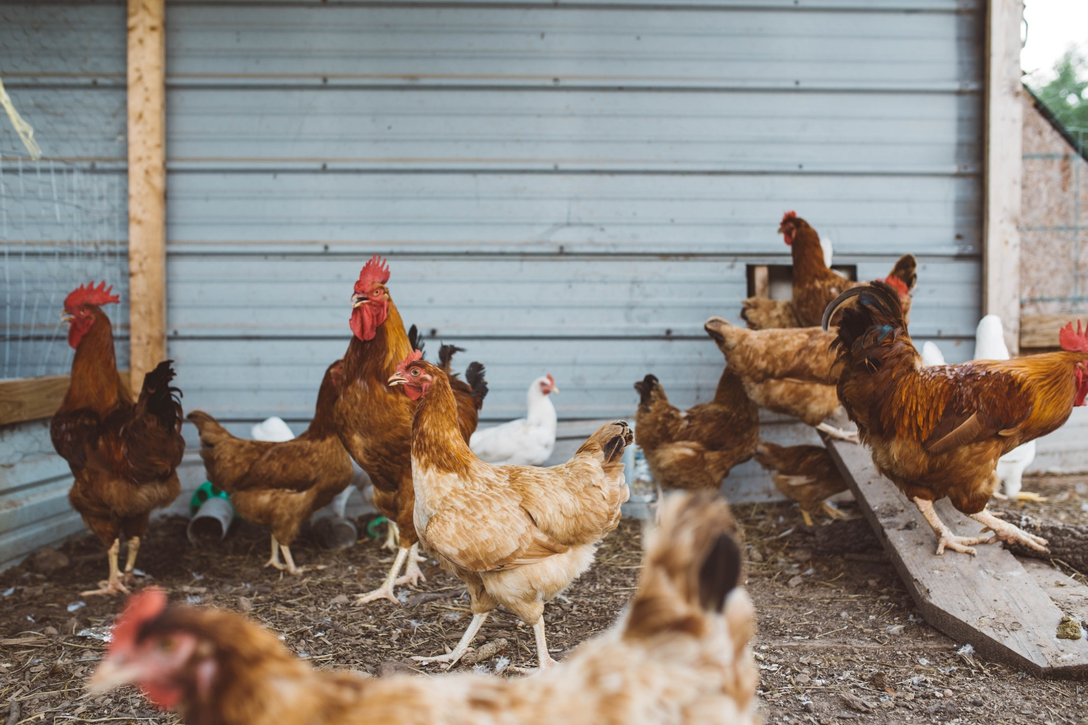
Chickens live in a chicken roost, which is like
a wooden shed for them to lay eggs in.

Slide 10
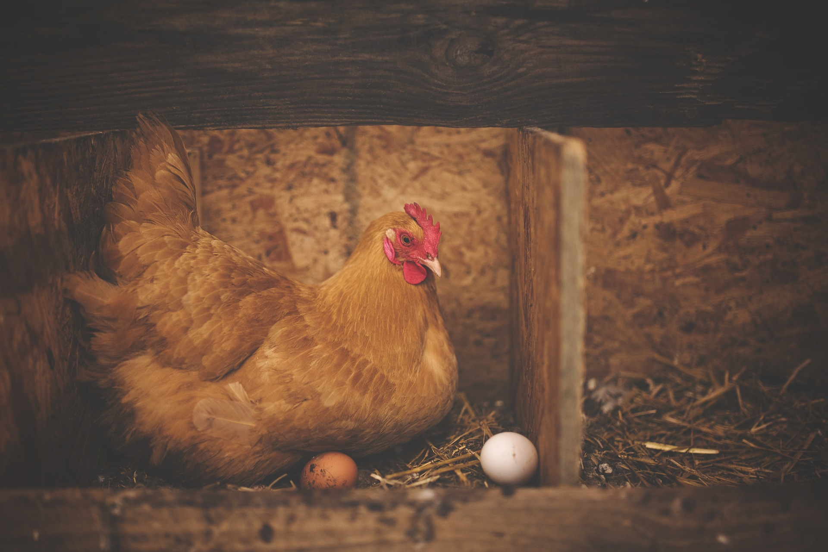
Chickens live in a chicken roost, which is like
a wooden shed for them to lay eggs in.
Back to the Farm

Slide 11
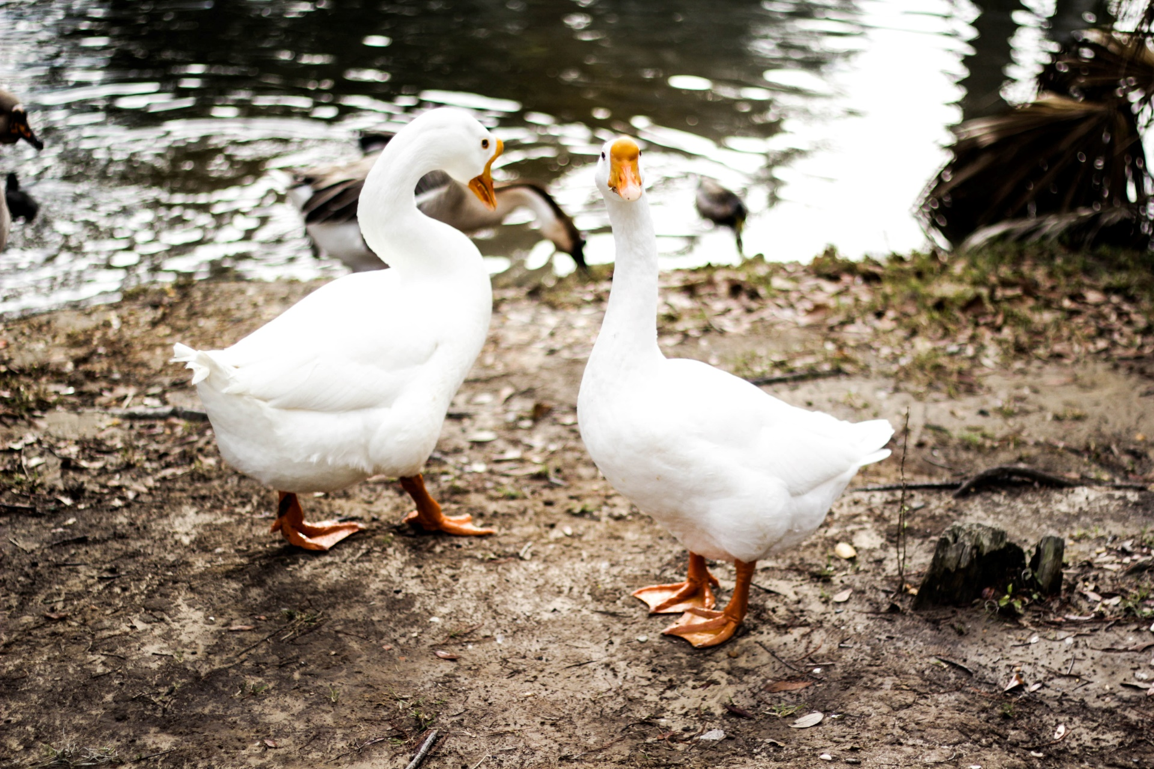
Geese and ducks like to live near ponds and water on
the farm, but they tend to roam around as well!

Slide 12
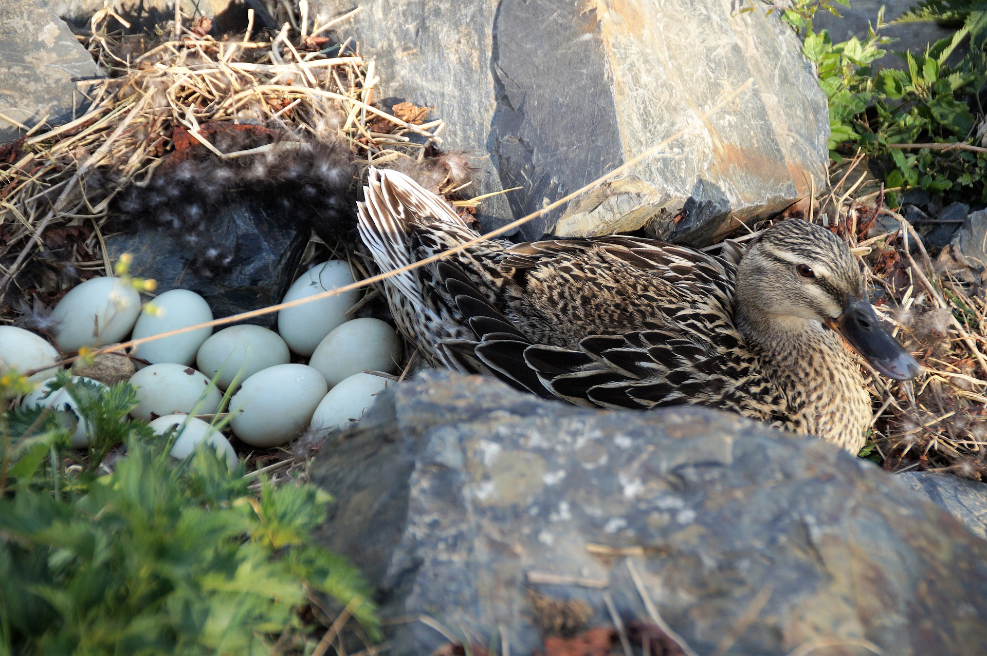
The farmer collects eggs from the ducks to sell.
Duck eggs are bigger than chicken eggs.
Back to the Farm

Slide 13
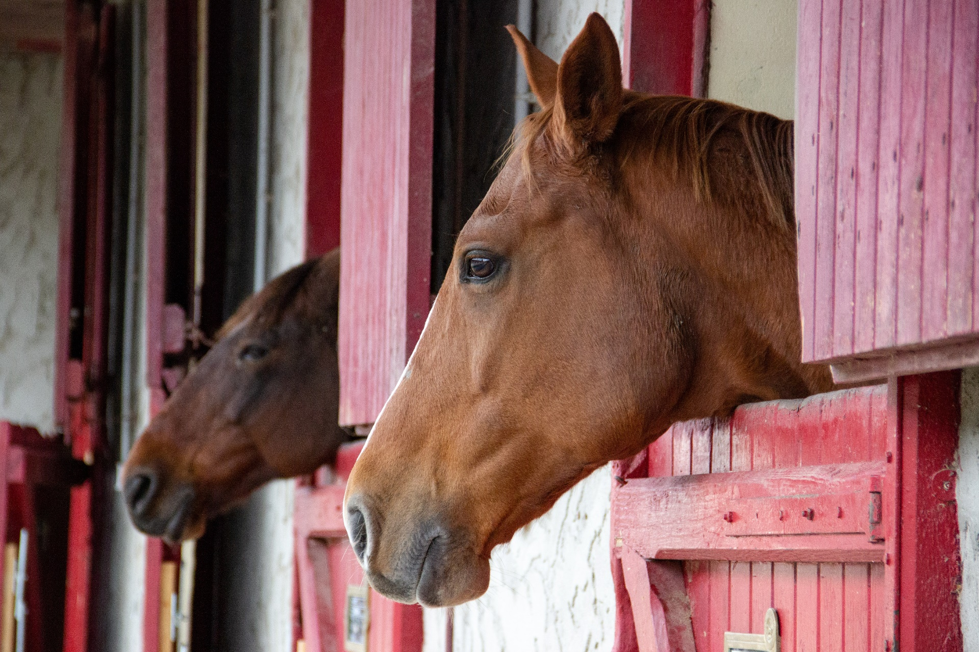
Horses and donkeys live outside and in stables.
They like to eat grass or hay.

Slide 14
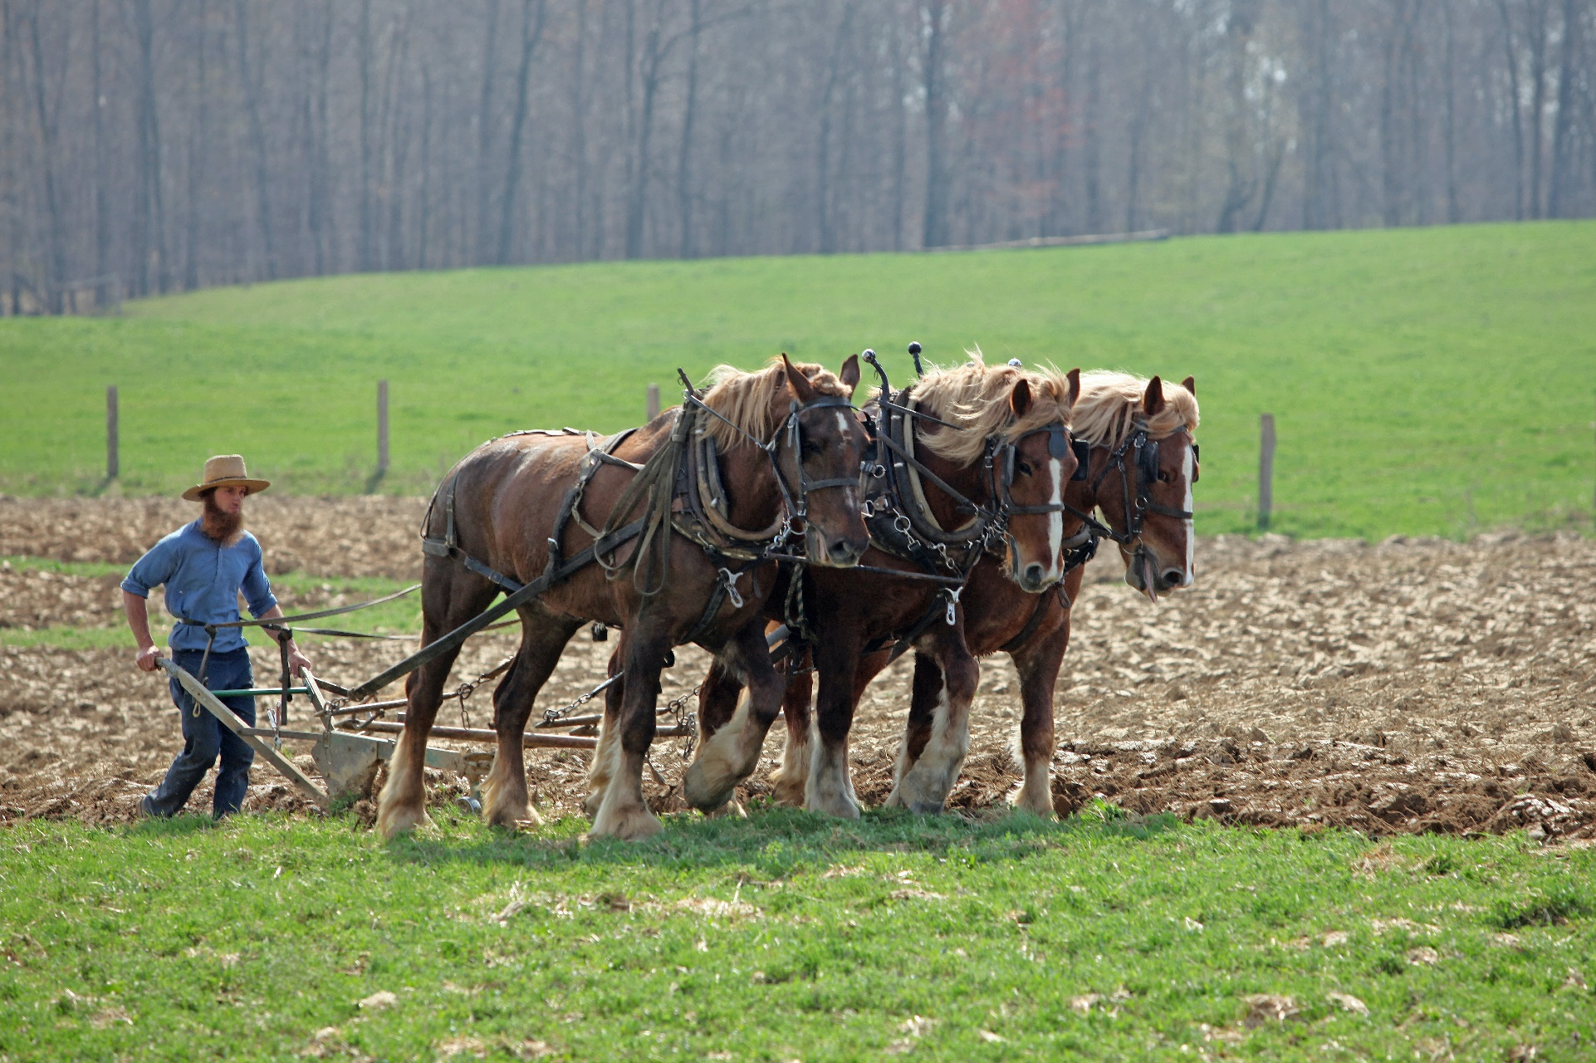
Some horses help on the farm by pulling the plough. Horses also
help the farm by providing manure, which is good for the crops.

Slide 15
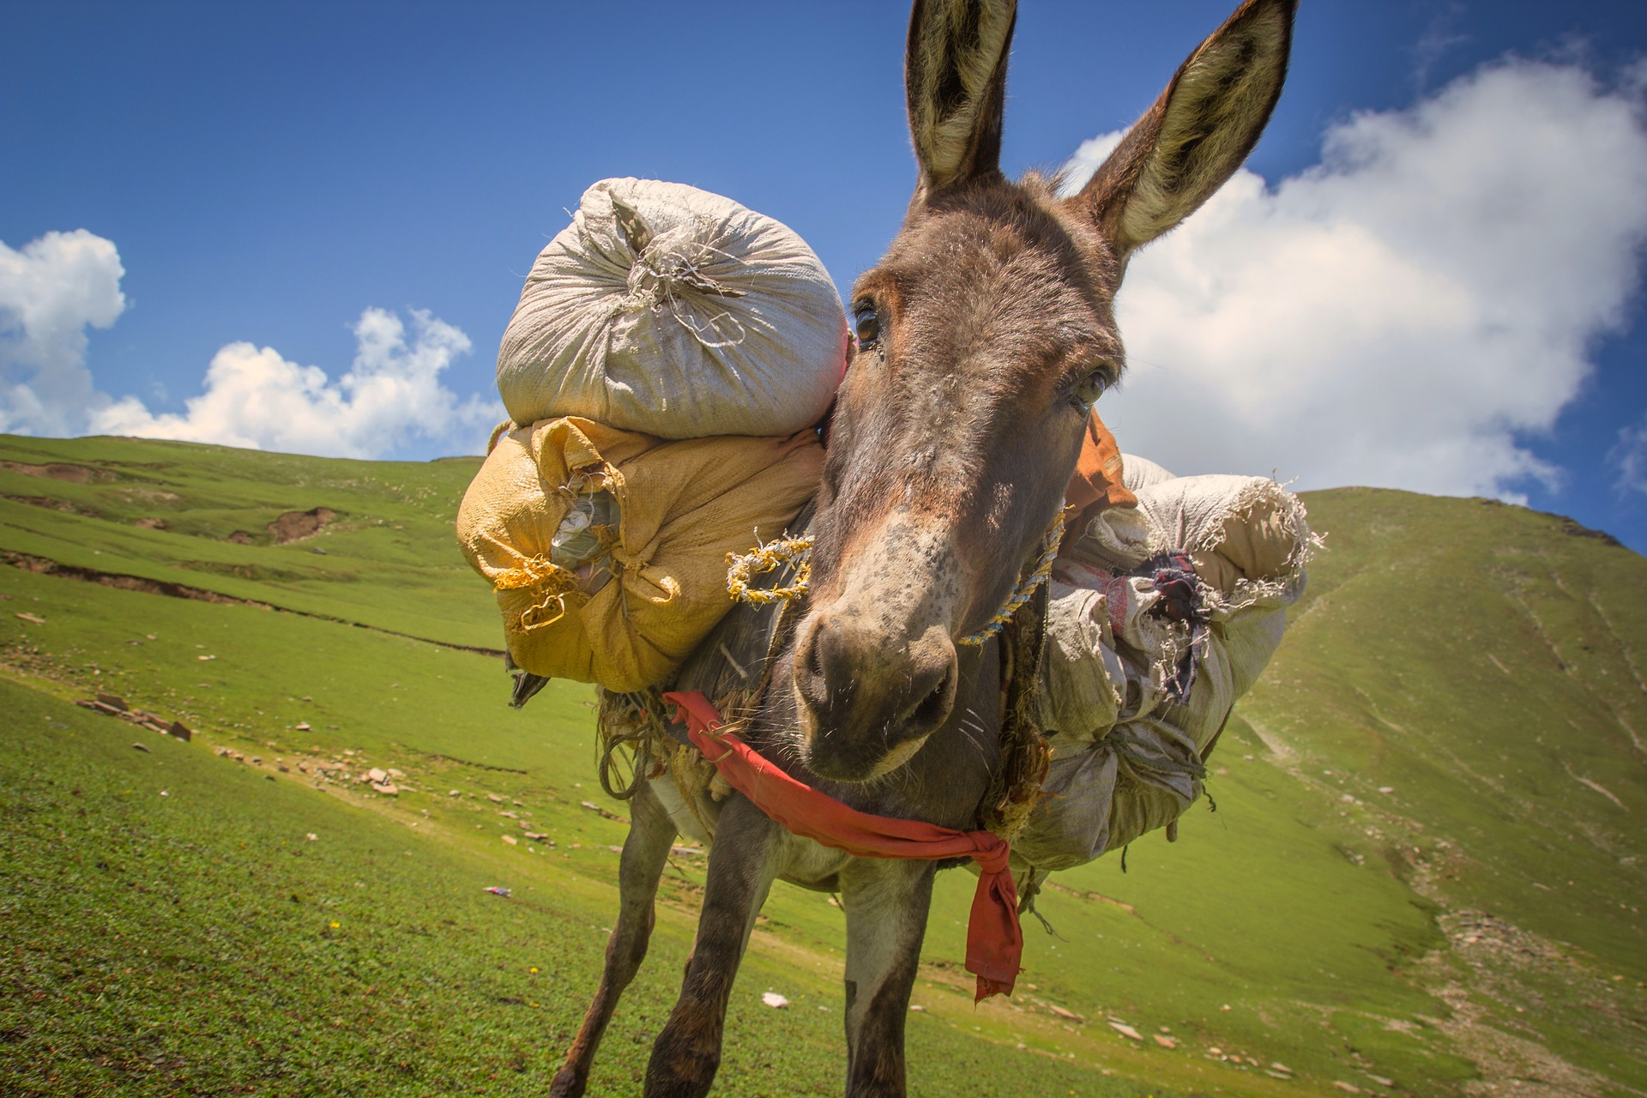
Sometimes donkeys help to carry things. They are very strong!
Back to the Farm

