Slide 1
Disclaimers
We hope you find the information on our website and resources useful. This resource contains links to external websites. Please be aware that the inclusion of any link in this resource should not be taken as an endorsement of any kind by Twinkl of the linked website or any association with its operators. You should also be aware that we have no control over the availability of the linked pages. If the link is not working, please let us know by contacting TwinklCares and we will try to fix it although we can assume no responsibility if this is the case. We are not responsible for the content of external sites.

Slide 3
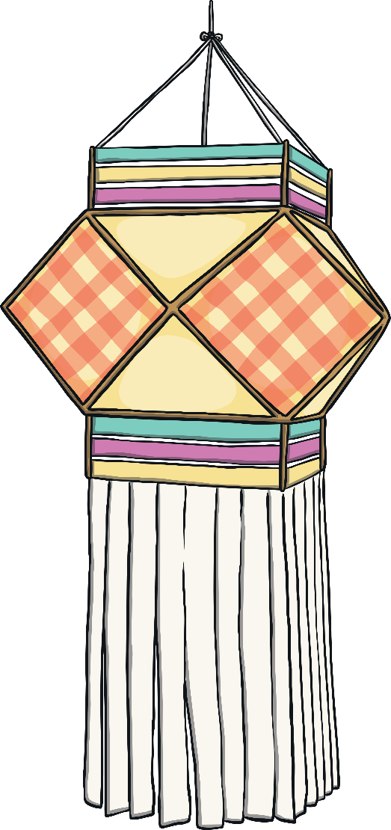
What is Diwali?
Diwali is a very important festival celebrated by many people around the world.
It is often celebrated by Hindus and Sikhs but can be celebrated by other religions too.
It is sometimes called the ‘festival of lights’.
It is celebrated in October or November each year.
Find out more by clicking here.

Slide 4
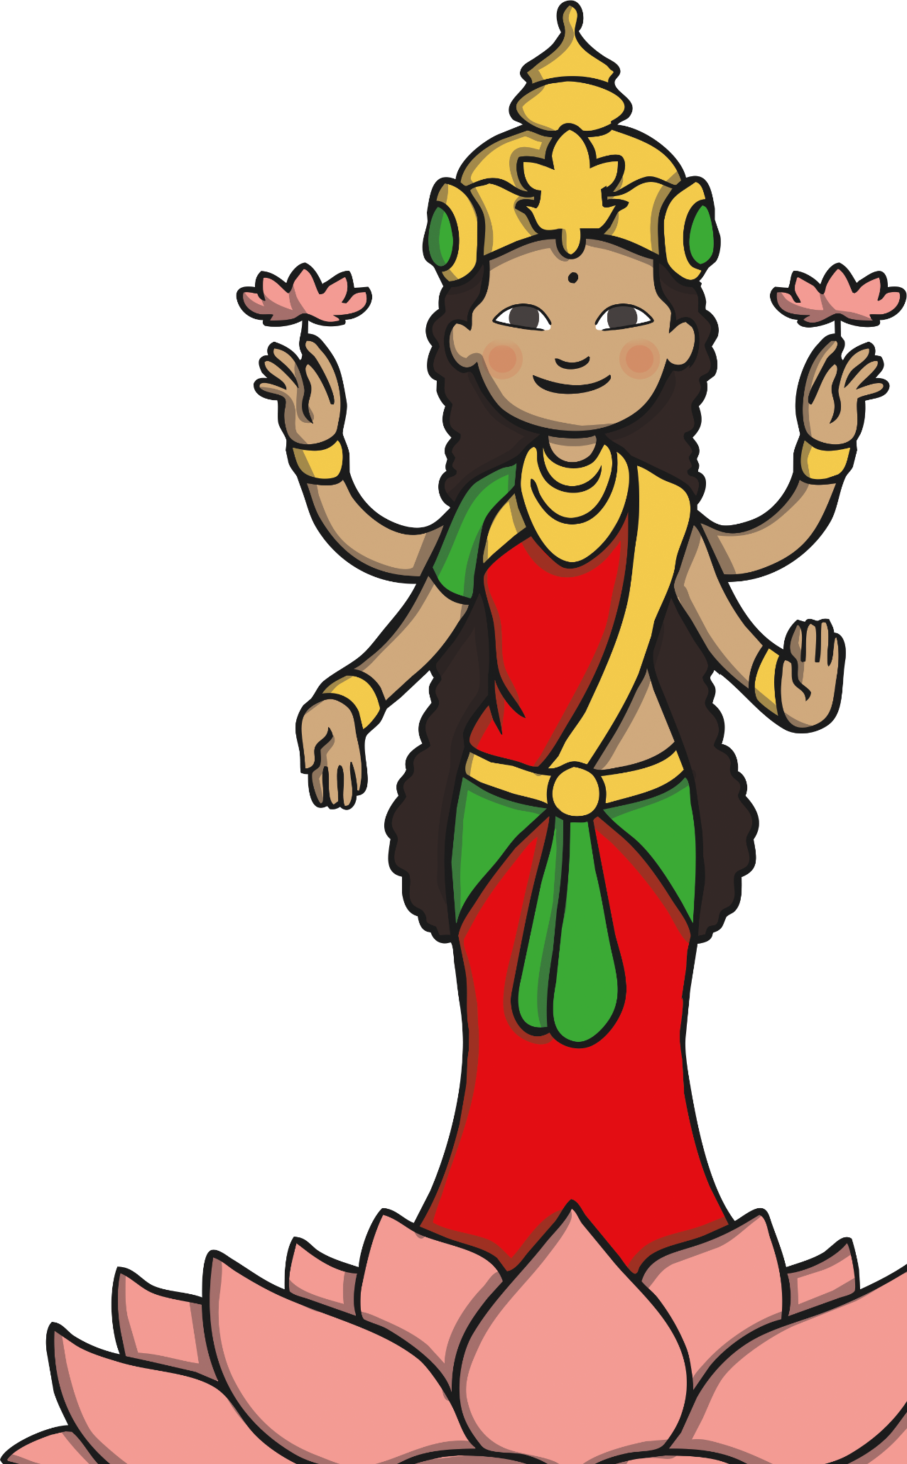
Why do Hindus Celebrate Diwali?
The Hindu festival usually honours Lakshmi, the goddess of wealth.
Lamps are lit to help Lakshmi find her way into people’s homes.
They also celebrate a Hindu Diwali legend; the story of the return of Rama and Sita to Rama’s kingdom after fourteen years of living away from their home.

Slide 5
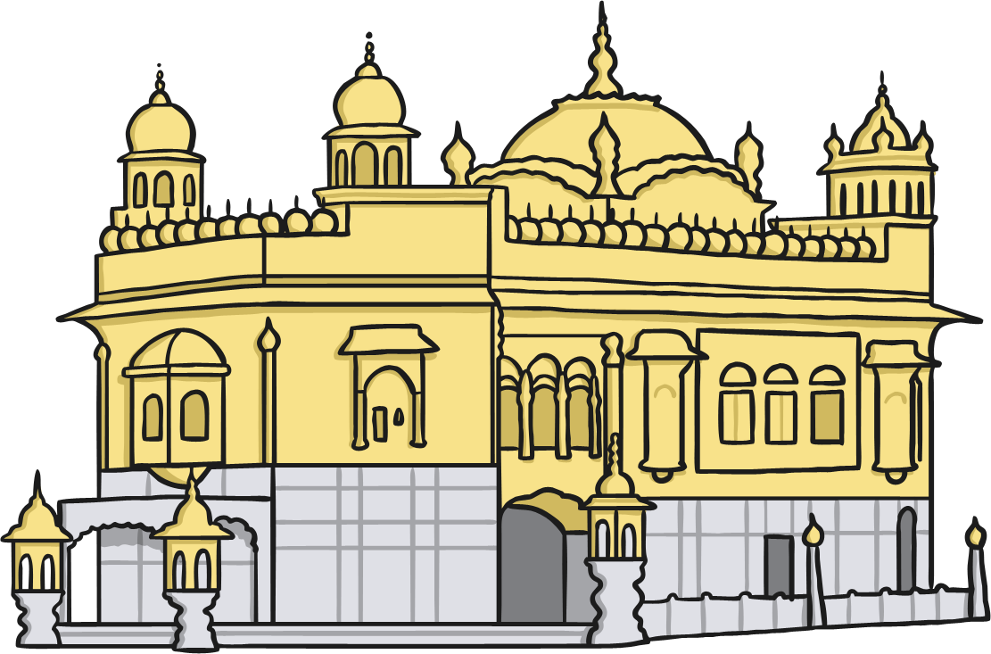
Why do Sikhs Celebrate Diwali?
The Sikh festival is important because it celebrates when
Guru Hargobind was released from prison.
When Guru Hargobind was released, he helped lots of other prisoners to be released too.
When he arrived in the city, Sikhs lit candles and lamps to celebrate his safe return.
During Diwali, the Golden Temple in India is lit by bright lights and there is often a fireworks display.

Slide 6

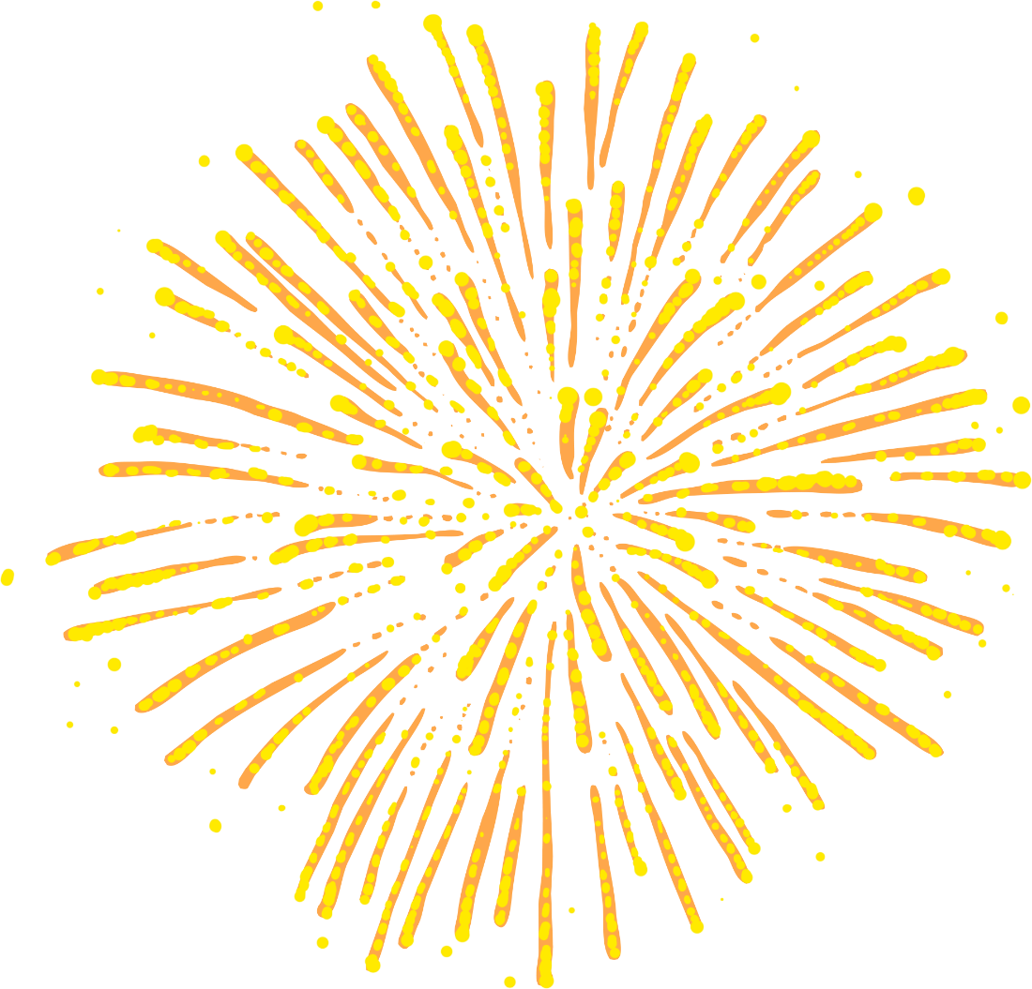

Celebrating Diwali
The festival is a time for:
spring cleaning the home;
decorating the home with lots of lights or diya lamps;
wearing new clothes;
exchanging gifts;
having meals with family and friends;
putting on huge firework displays.

Slide 7
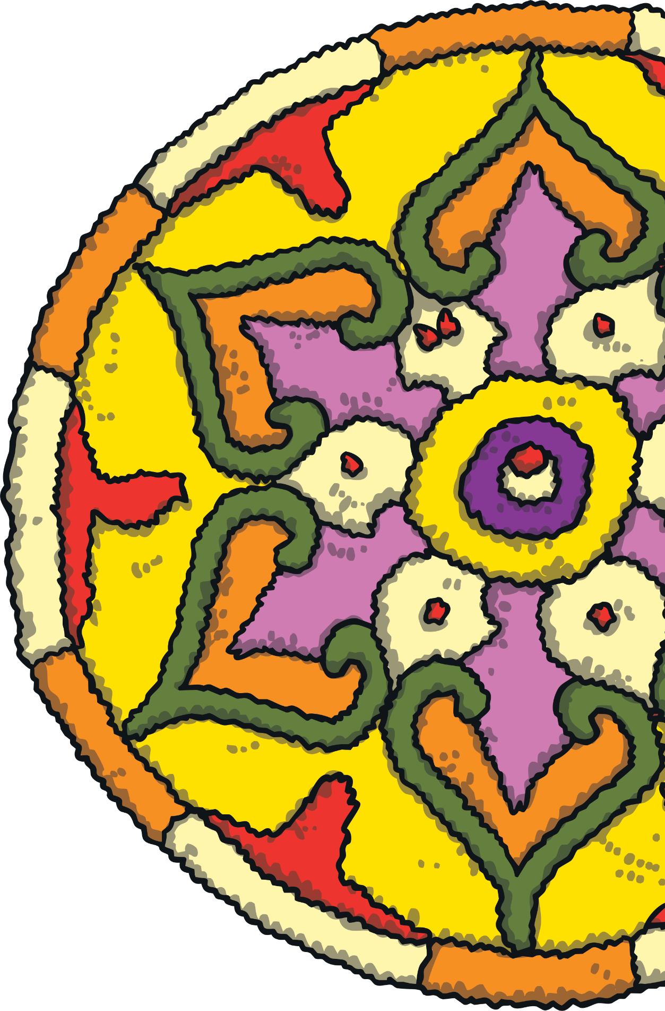
Celebrating Diwali
In India, Hindus leave the windows and doors of their houses open so that Lakshmi can come in.
Rangoli are drawn on the floors
of Hindu houses.
Rangoli are patterns and the most popular subject is the lotus flower.
The patterns are made using coloured rice, sand, flowers or paint.

Slide 8
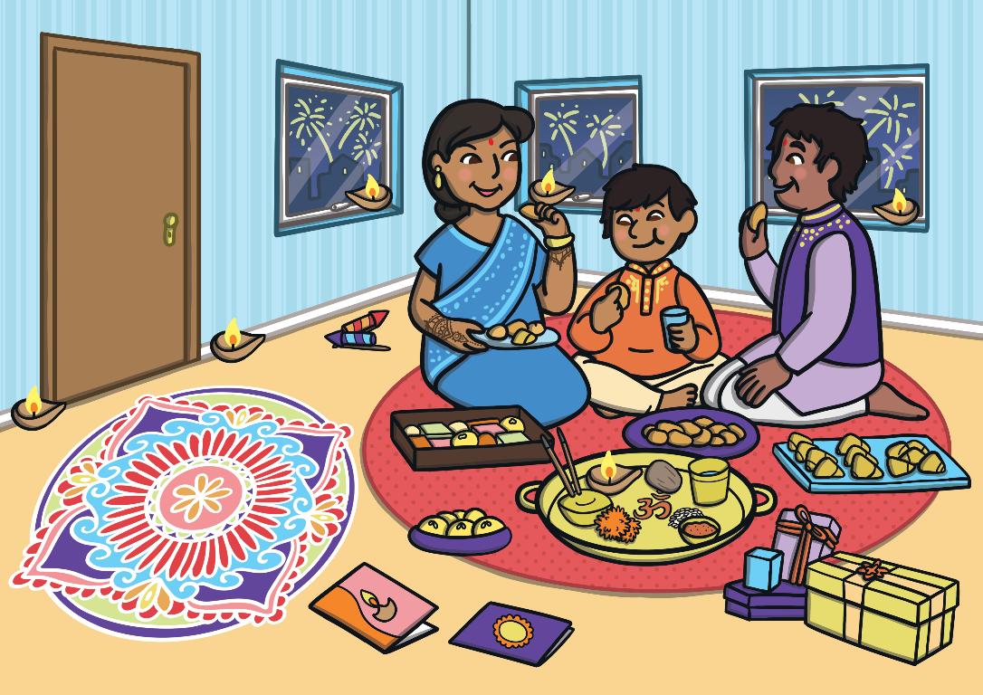
What Did You Find Out?
What did you learn about Diwali and how it is celebrated?
Tell a friend what you can see in this picture and the photos on the next pages.

Slide 9
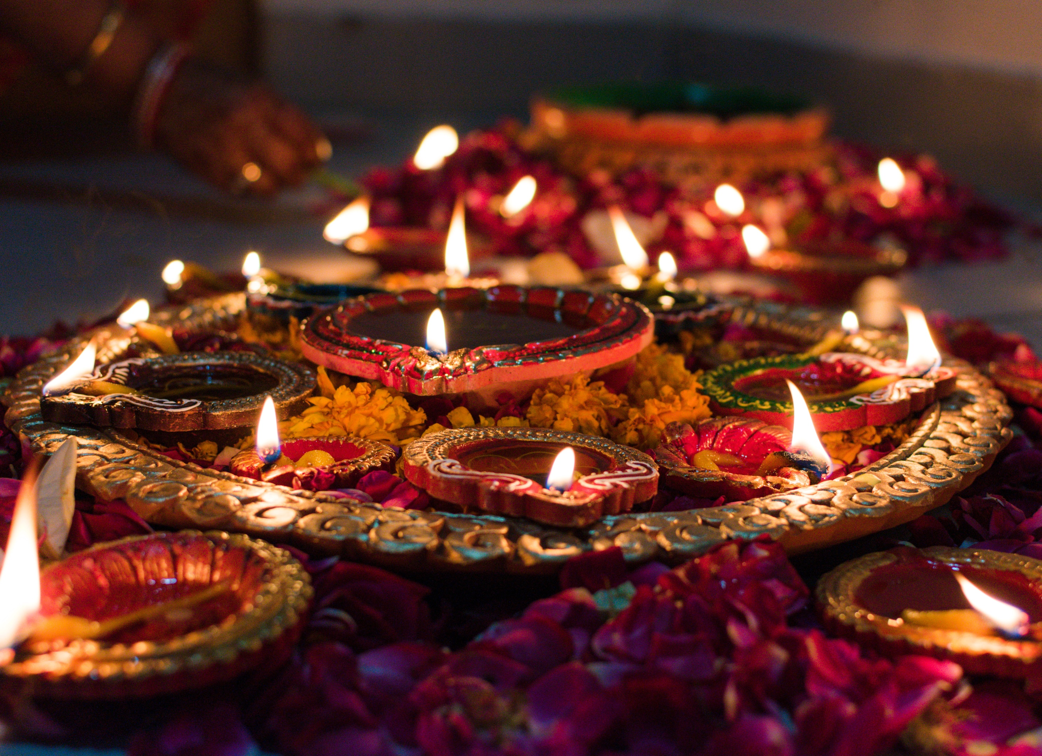

Slide 10
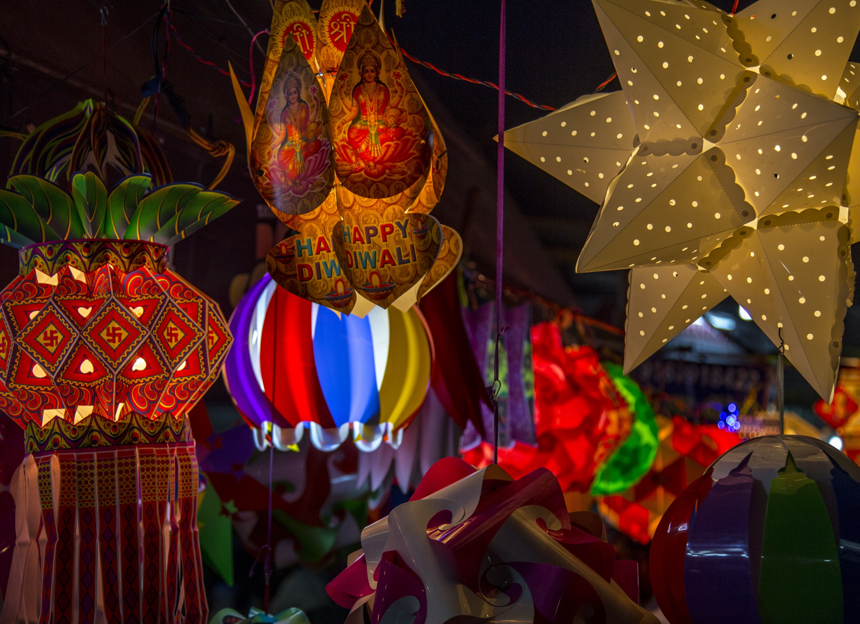

Slide 11
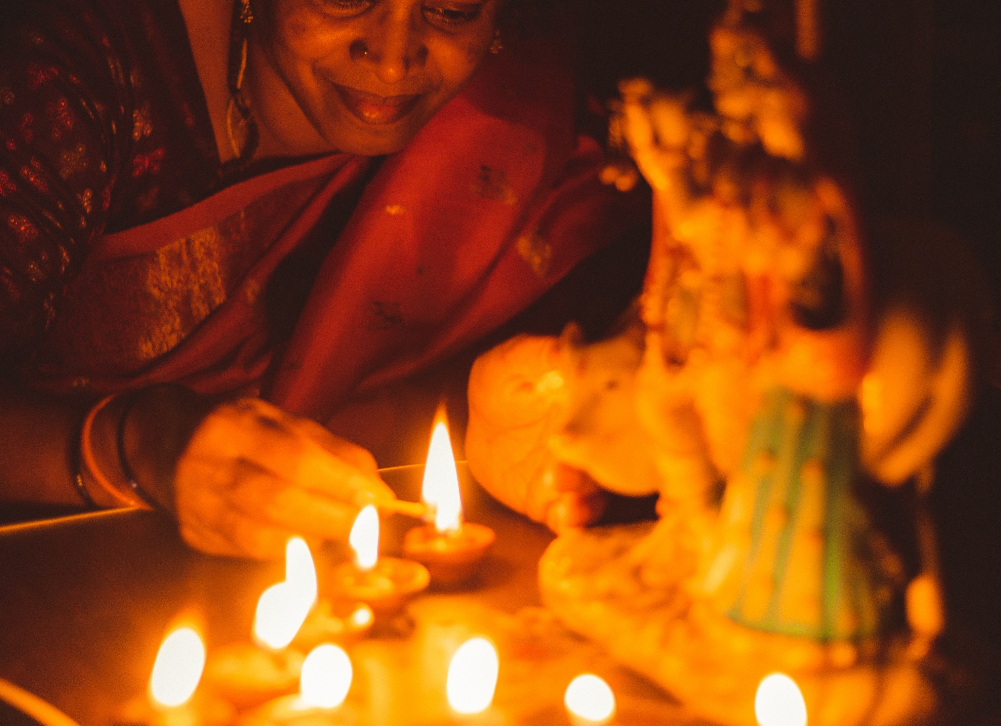

Slide 12
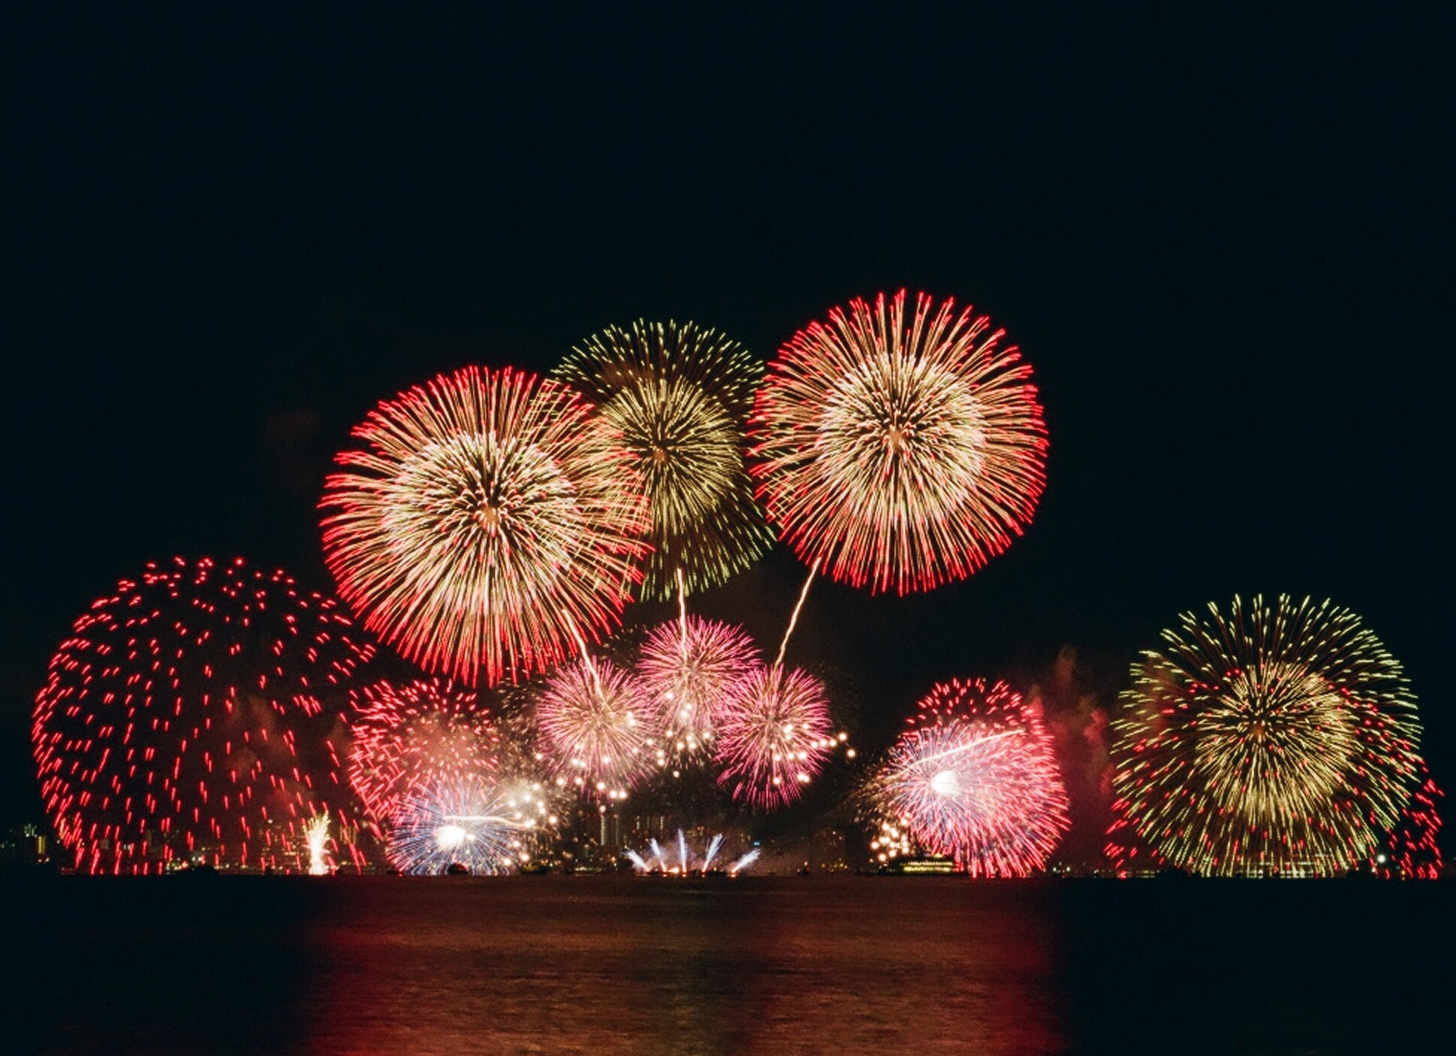

Slide 13


