Slide 2

First Day
‘Let there be light’.
On the first day, God created light and dark. He separated the light from the dark and called the light ‘day’ and the dark ‘night’.

Slide 3

Second Day
‘Let there be something to divide the water in two’.
On the second day, God created the sky. He used the sky to separate
the water.

Slide 4
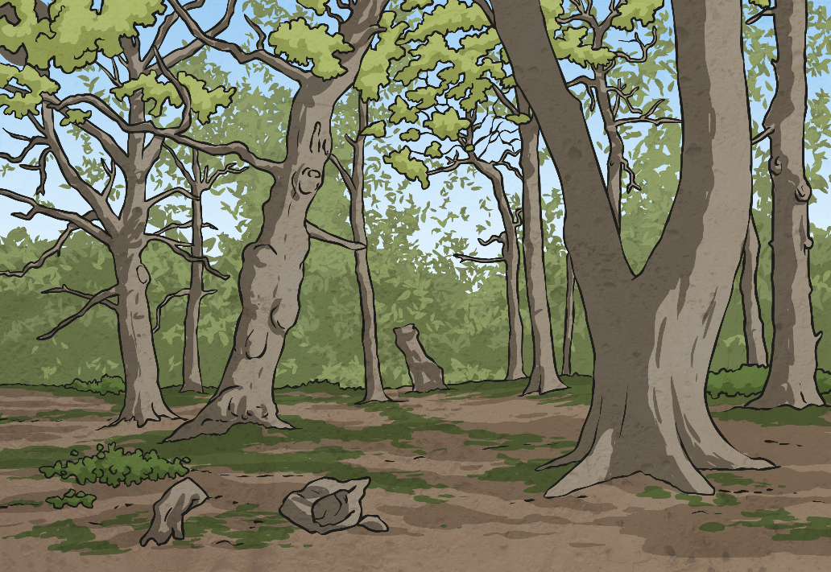
Third Day
‘Let the earth produce plants’.
On the third day, God created land. He gathered the water together to create the seas. The dry land was named “earth”. He also created trees and plants.

Slide 5
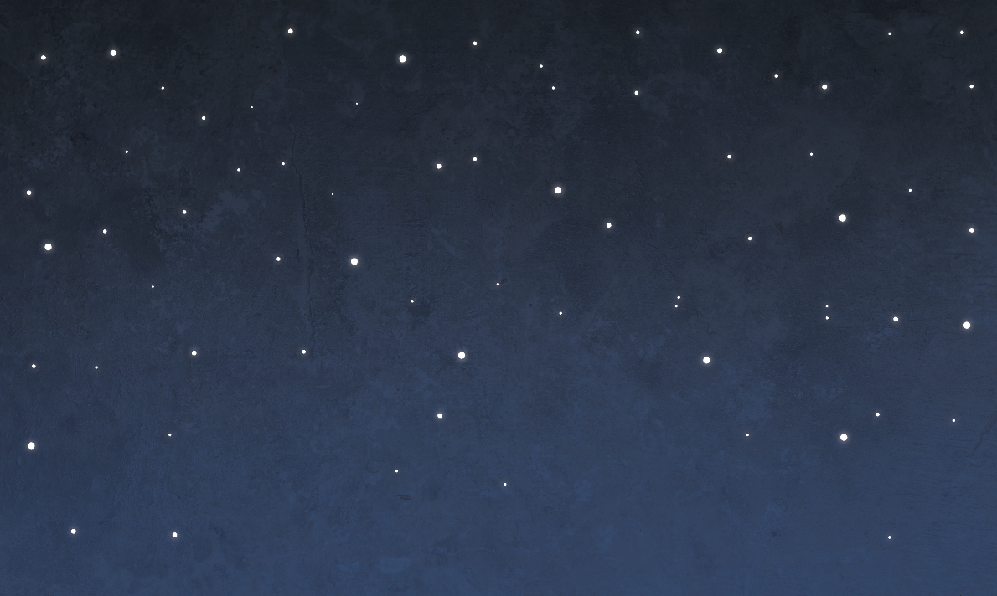
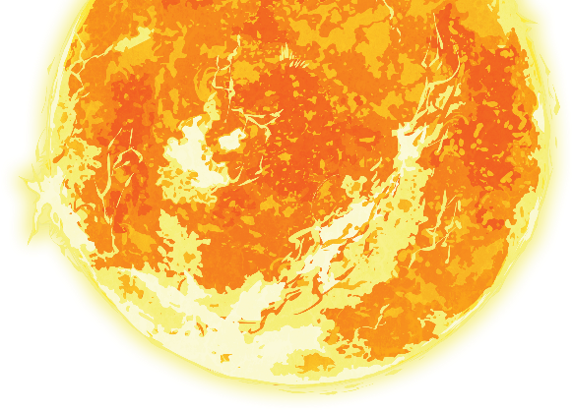
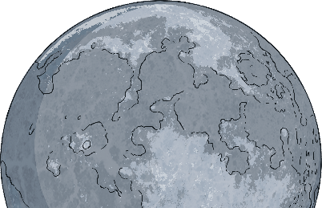
Fourth Day
‘They will be in the
sky to give light on the earth’.
On the fourth day, God created the Sun, the Moon and the stars, to separate the light from the darkness.

Slide 6
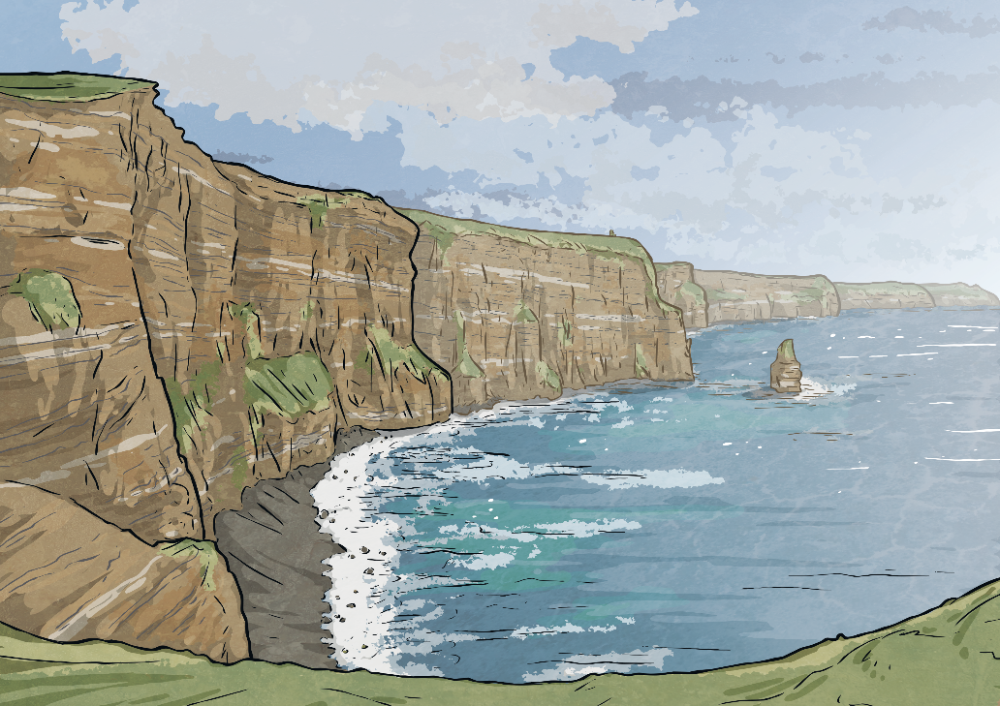


Fifth Day
‘Fill the water of the seas and let the birds grow in number on the earth’.
On the fifth day, God created living creatures for the sky and sea.

Slide 7
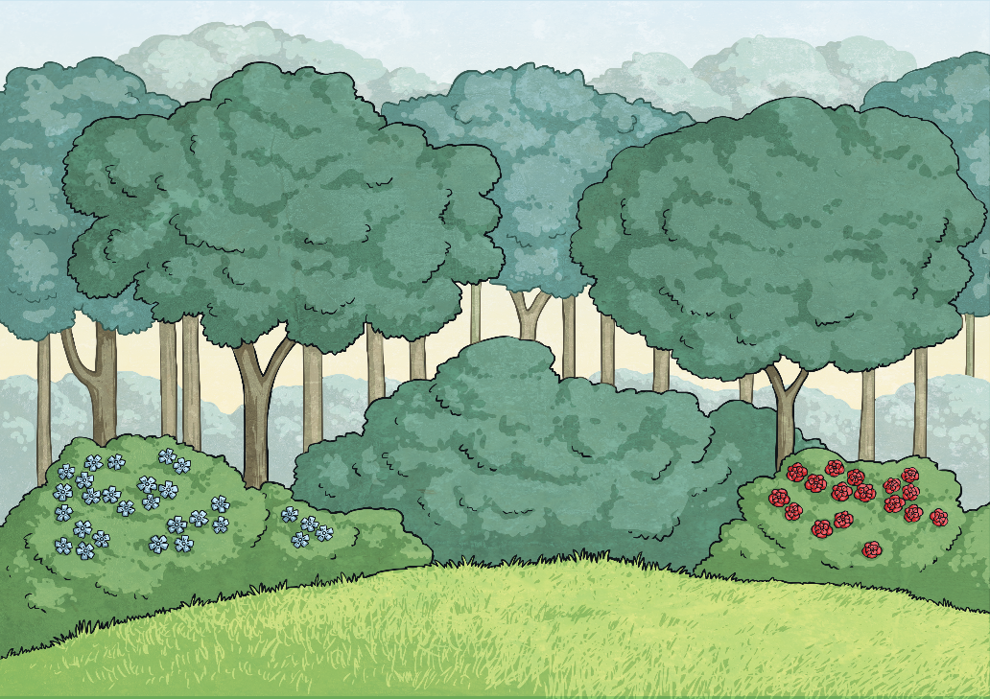
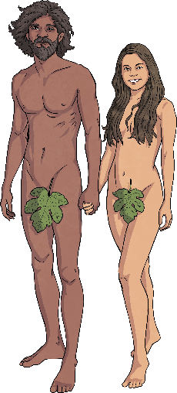
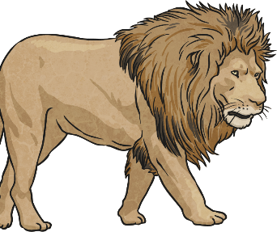
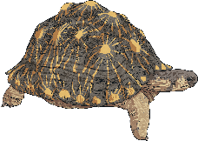
Sixth Day
‘Fill the earth
and be its master.’
On the sixth day, God created many different animals. He also created human beings in his image. He gave humans the responsibility of looking after all the animals.

Slide 8
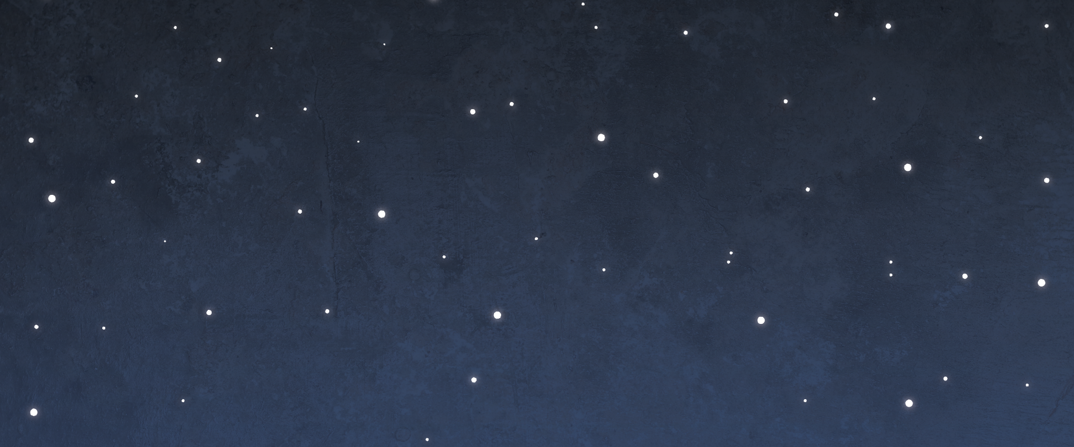
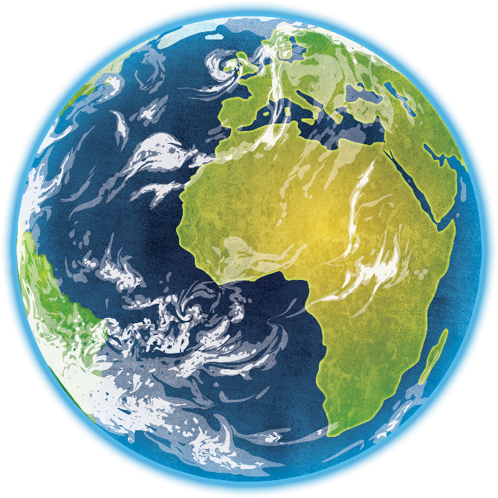
Seventh Day
God looked at all he had created and was pleased. On the seventh day, he rested. God blessed the seventh day and made it a holy day.

