Slide 2
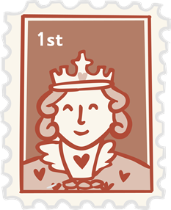

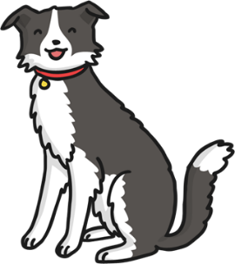






Click the pictures that begin with ‘s’ to move them into the middle.
s

Slide 3

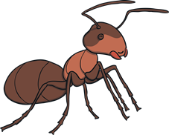

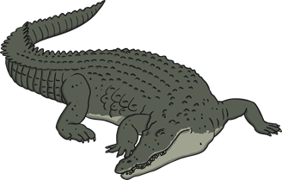

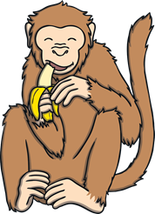
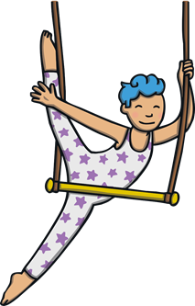


Click the pictures that begin with ‘a’ to move them into the middle.
a

Slide 4


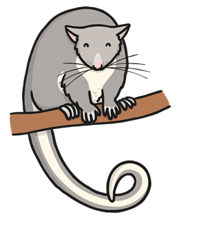





Click the pictures that begin with ‘t’ to move them into the middle.
t

Slide 5
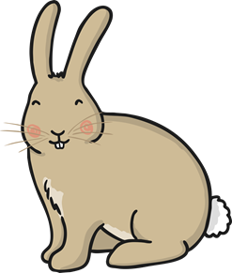







Click the pictures that begin with ‘p’ to move them into the middle.
p

Slide 6









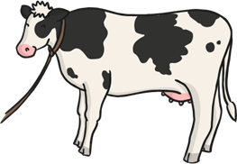

Click the pictures that begin with ‘i’ to move them into the middle.
i

Slide 7



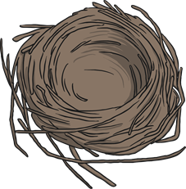

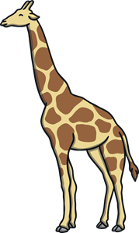

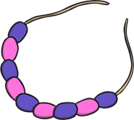
Click the pictures that begin with ‘n’ to move them into the middle.
n

Slide 8
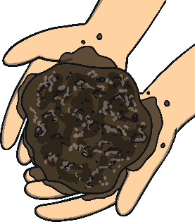
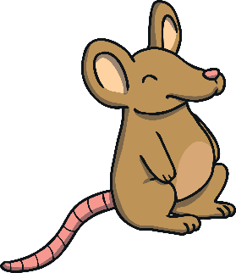

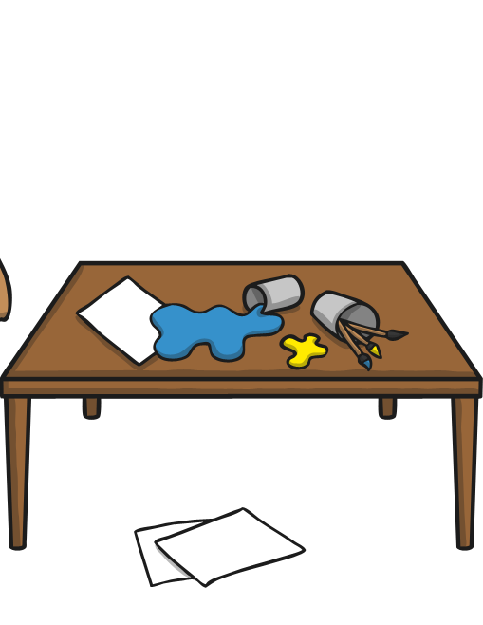
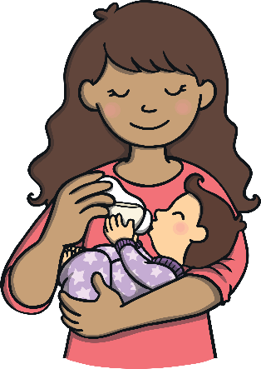

Click the pictures that begin with ‘m’ to move them into the middle.
m

Slide 9

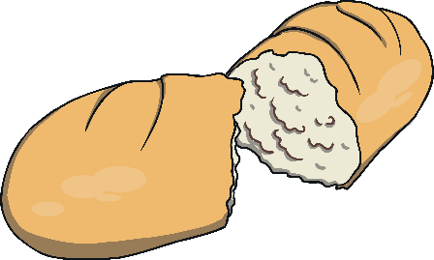
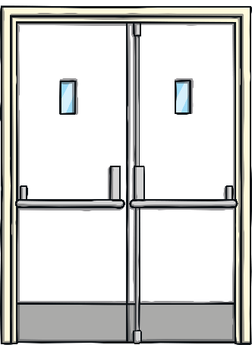
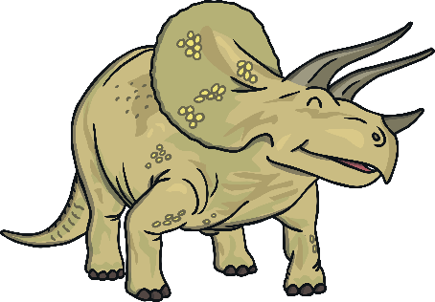
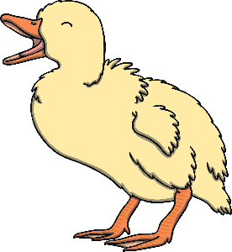


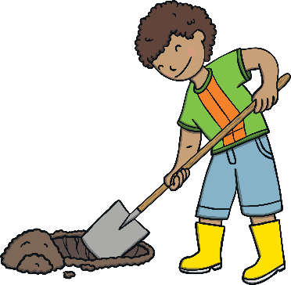
Click the pictures that begin with ‘d’ to move them into the middle.
d

Slide 10

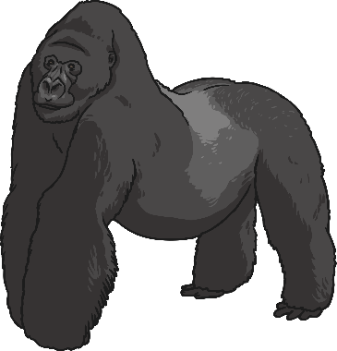
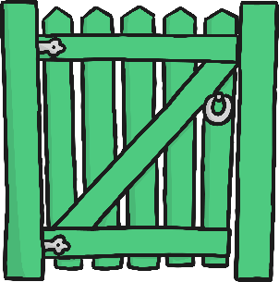
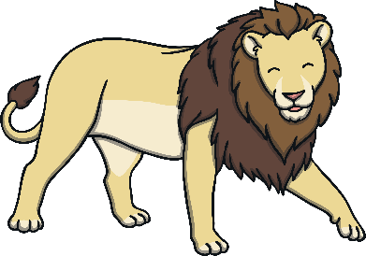

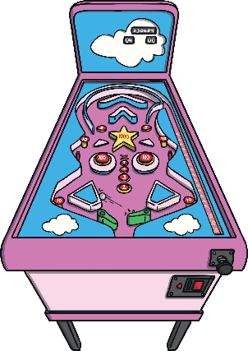

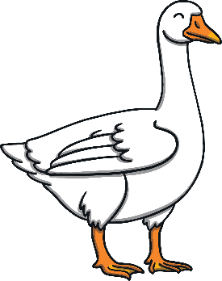
Click the pictures that begin with ‘g’ to move them into the middle.
g

Slide 11
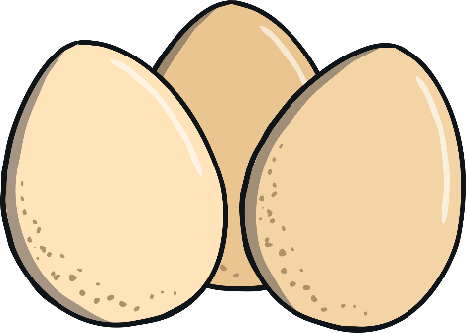

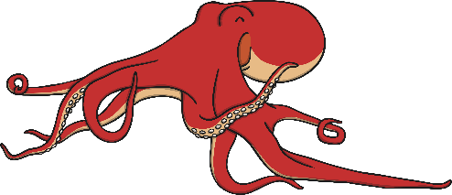
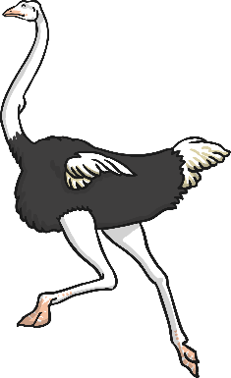
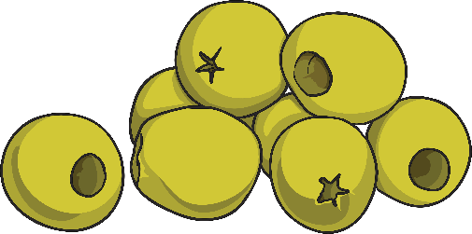

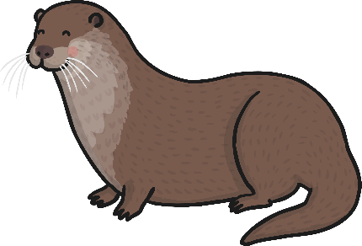
Click the pictures that begin with ‘o’ to move them into the middle.
o

Slide 12



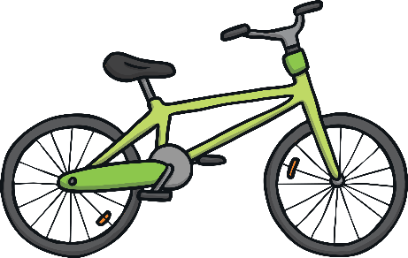


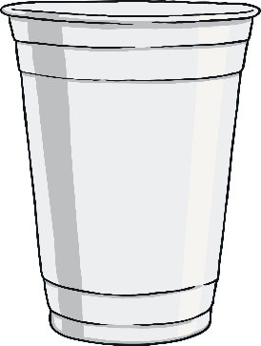

Click the pictures that begin with ‘c’ to move them into the middle.
c

Slide 13
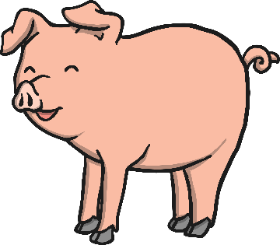
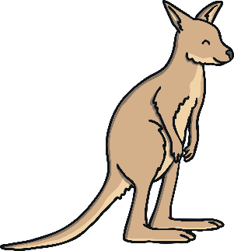
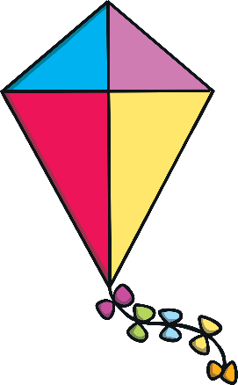
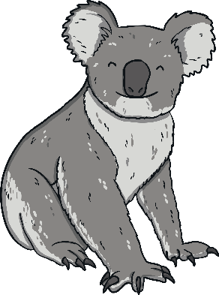
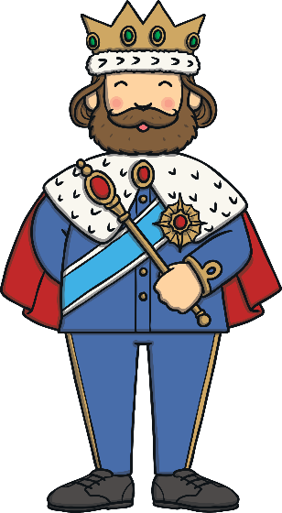
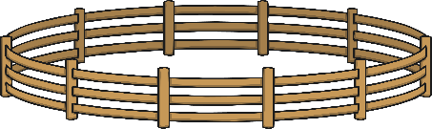


Click the pictures that begin with ‘k’ to move them into the middle.
k

Slide 14
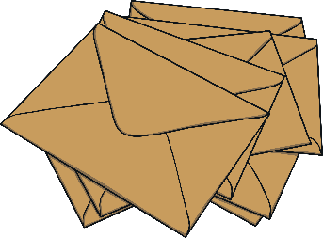


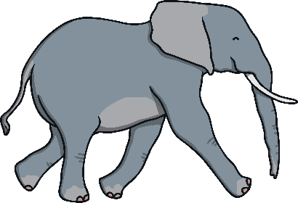
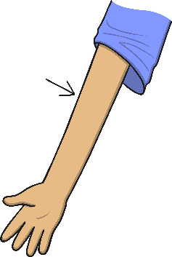

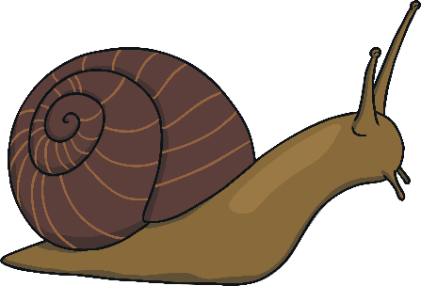
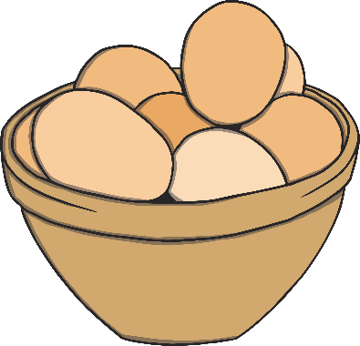
Click the pictures that begin with ‘e’ to move them into the middle.
e

Slide 15





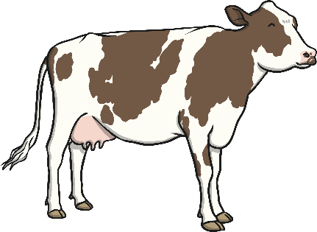
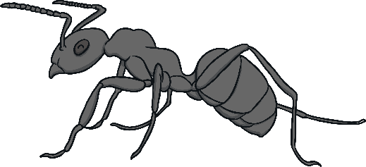
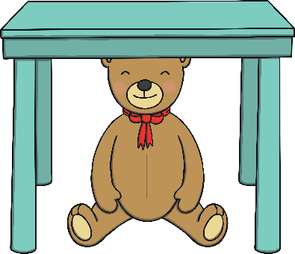
Click the pictures that begin with ‘u’ to move them into the middle.
u

Slide 16

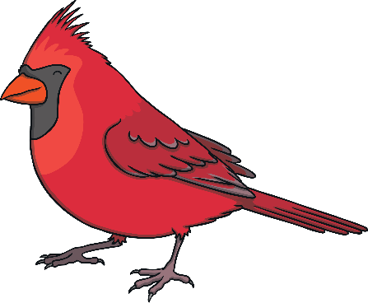


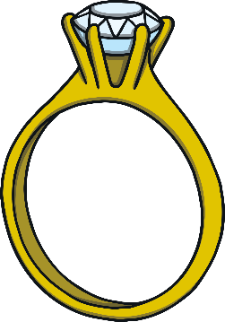
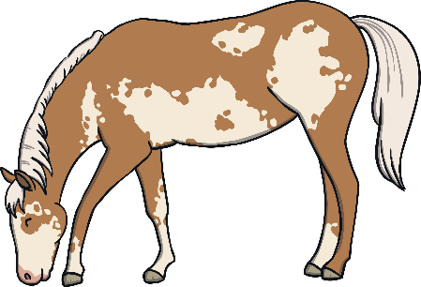


Click the pictures that begin with ‘r’ to move them into the middle.
r

Slide 17








Click the pictures that begin with ‘h’ to move them into the middle.
h

Slide 18








Click the pictures that begin with ‘f’ to move them into the middle.
f

Slide 19








Click the pictures that begin with ‘l’ to move them into the middle.
l

Slide 20








Click the pictures that begin with ‘b’ to move them into the middle.
b

Slide 21








Click the pictures that begin with ‘v’ to move them into the middle.
v

Slide 22








Click the pictures that begin with ‘w’ to move them into the middle.
w

Slide 23




Click the pictures that begin with ‘x’ to move them into the middle.
x

Slide 24








Click the pictures that begin with ‘y’ to move them into the middle.
y

Slide 25






Click the pictures that begin with ‘z’ to move them into the middle.
z

Slide 26








Click the pictures that begin with ‘q’ to move them into the middle.
q

Slide 27








Click the pictures that begin with ‘r’ to move them into the middle.
r

Slide 28








Click the pictures that begin with ‘j’ to move them into the middle.
j

Slide 29








Click the pictures that begin with ‘k’ to move them into the middle.
k

