Slide 2
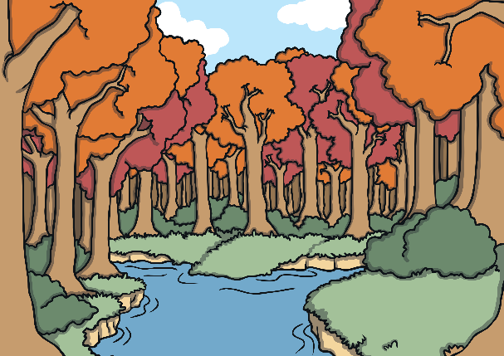

How We Can Help the Environment
The environment is the natural world.
To help the environment, we can think about how our lives and actions affect the
natural world.
We can all make small changes that will help the environment.
If everyone in the world made one small change to help the environment, imagine the positive difference we could make!

Slide 3
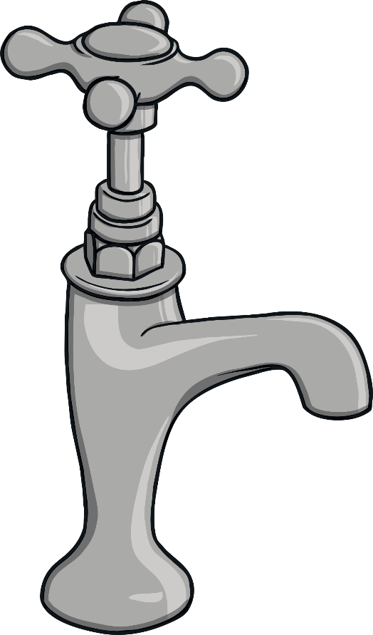

Turn off the Tap When You Brush Your Teeth
By turning off the tap when you brush your teeth, you will save around 12 litres of water.
If you brush your teeth twice a day, this will save 24 litres of water each day, or 168 litres a week!

Slide 4
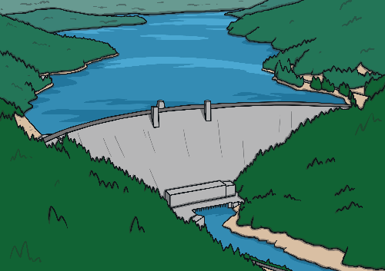
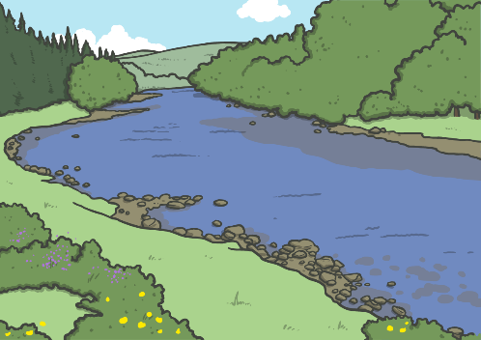
How Does Saving Water Help the Environment?
Less water is used from rivers, lochs and reservoirs.
Less energy is needed to clean and pump the wastewater.

Slide 5
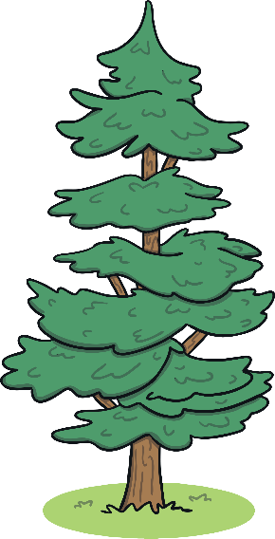



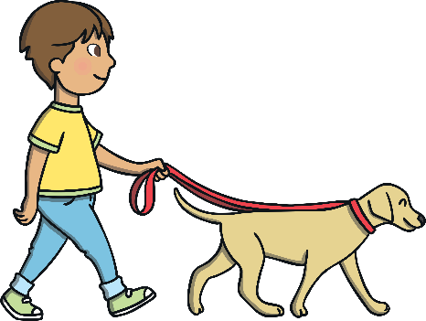
Use Both Sides of Paper When You are Drawing or Writing
This helps to save trees, as paper is made from trees.
Trees are very important to the environment as they absorb a gas called carbon dioxide and make a gas called oxygen. We need oxygen to breathe.

Slide 6



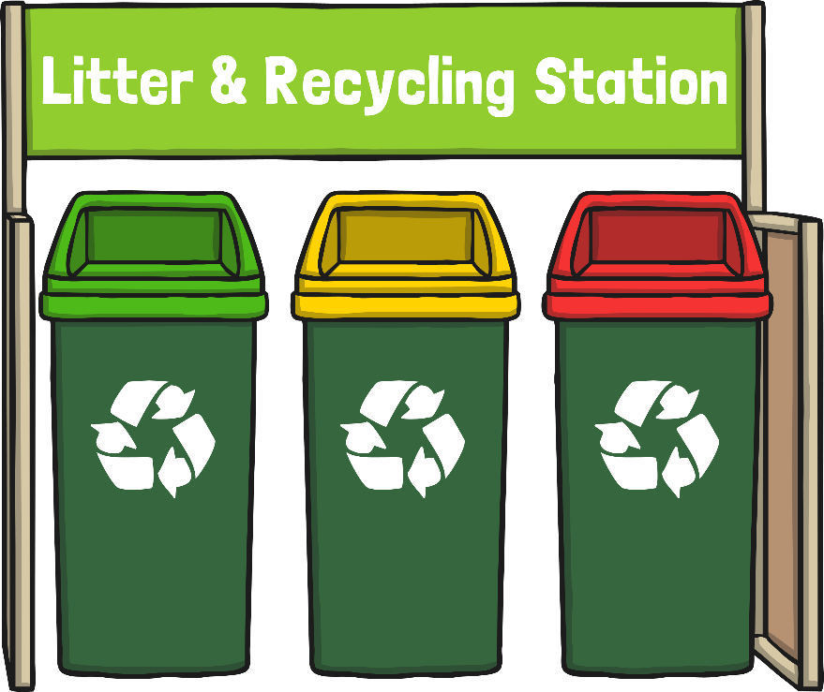
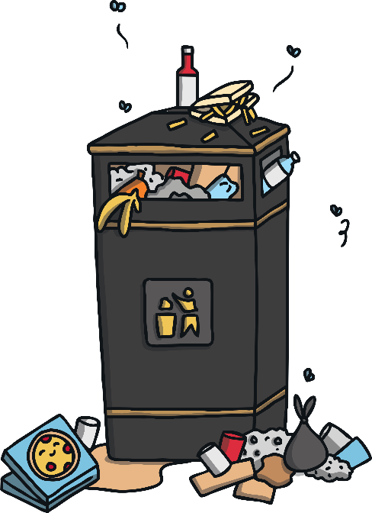


Sort and Recycle Your Rubbish
Recycle plastic, paper and food waste by sorting them into the correct bins.
Recycling helps to reduce waste and means less rubbish ends up in landfill sites.

Slide 7
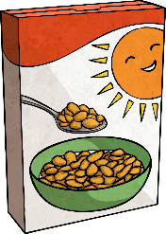
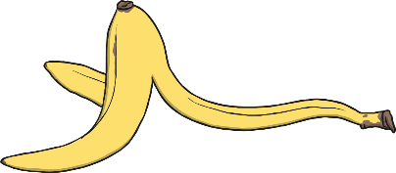
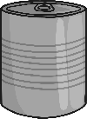
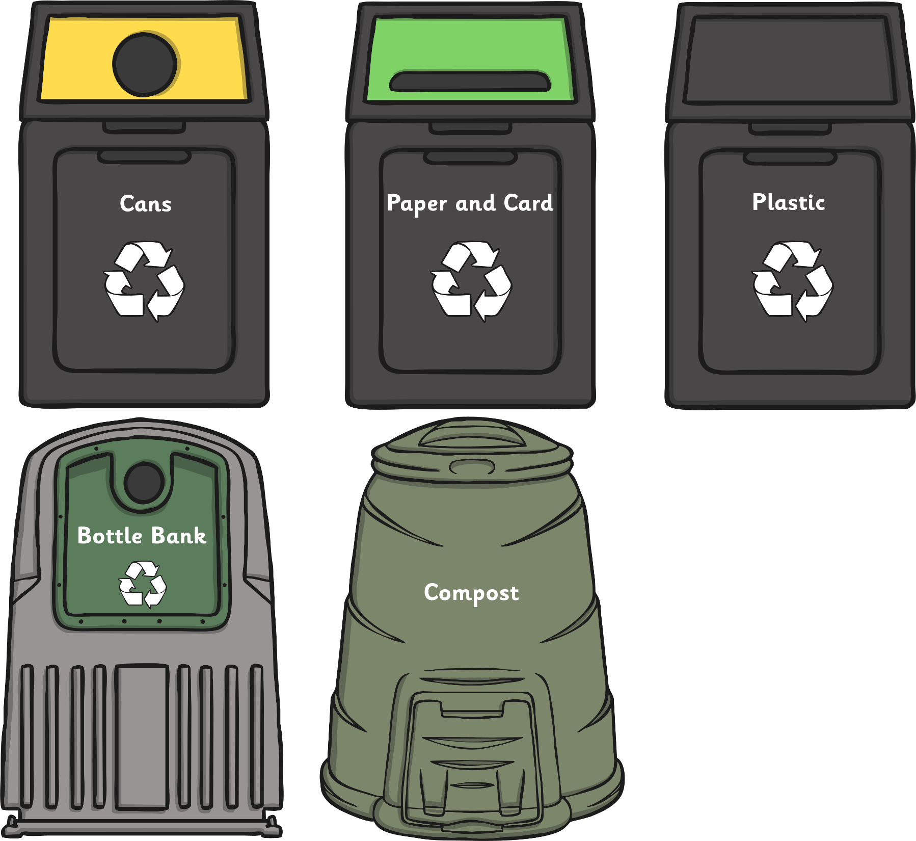
Can You Sort and Recycle This Rubbish?

Slide 8
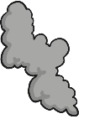
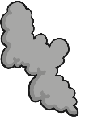
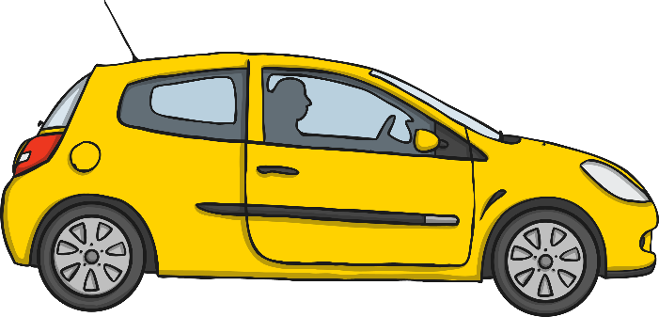


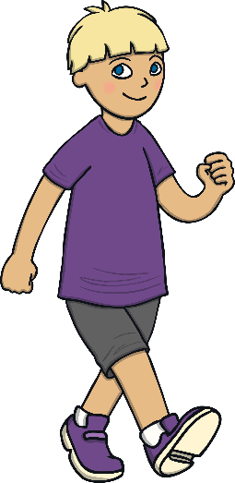
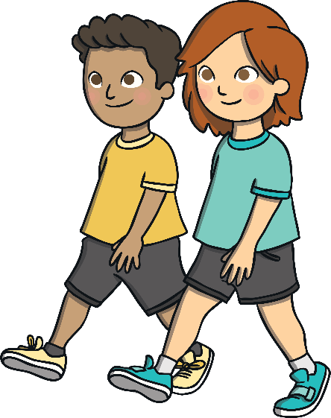
Walk Instead of Going by Car
Cars produce harmful gases that can damage the environment.
Walking is good exercise and helps you to stay fit and healthy.

Slide 9
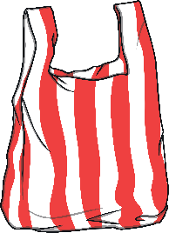
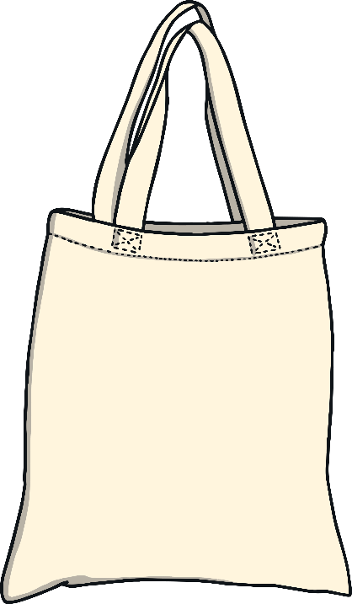
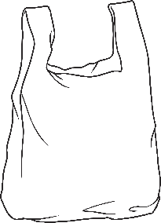
Take a Reusable Bag When You Go to the Supermarket or Shops
Using reusable bags helps us to use fewer plastic bags, which can damage the environment if they become rubbish.

Slide 10




Use a Refillable Water Bottle
This helps to reduce plastic waste and saves you money.

Slide 11




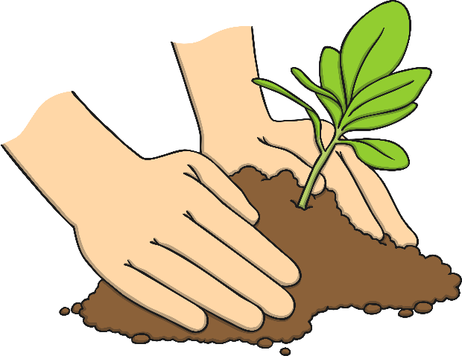
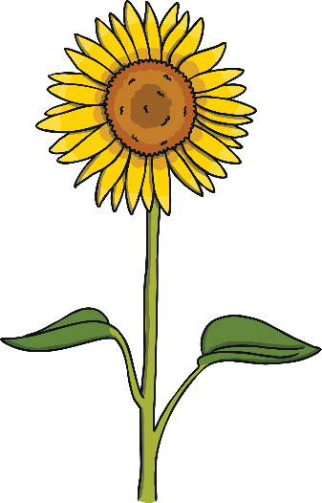
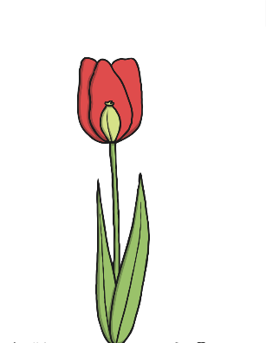

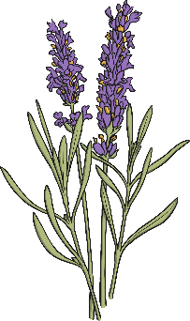




Plant Seeds in Your Garden
Growing plants helps the environment, as plants release oxygen and absorb carbon dioxide. Plants also provide food and a place to live for lots of insects, animals and birds.

Slide 12
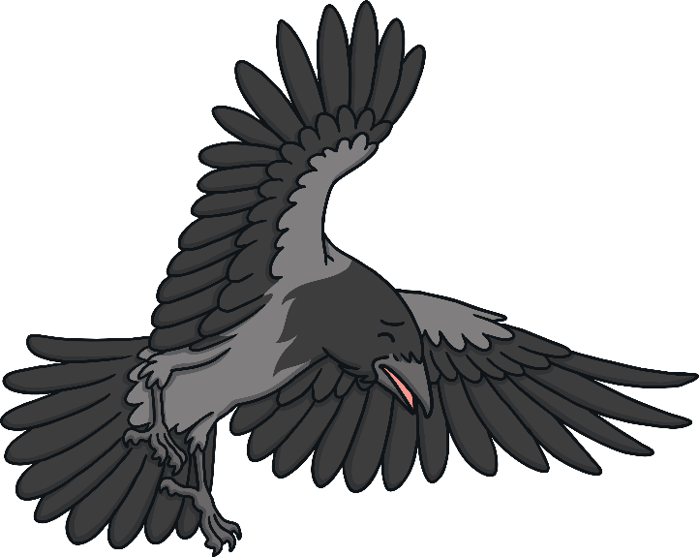
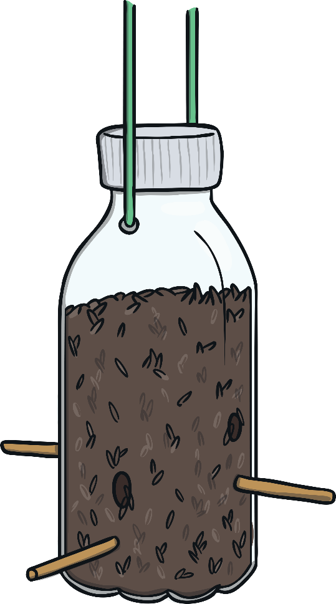
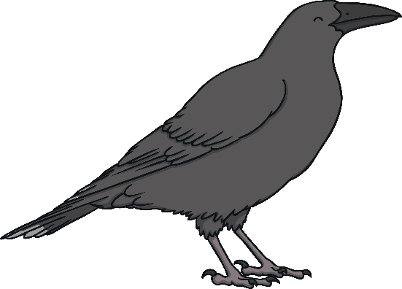
Feed the Birds in Winter
Birds often struggle to find enough food in cold weather so you can help them by leaving seeds and bird food in your garden.

Slide 13
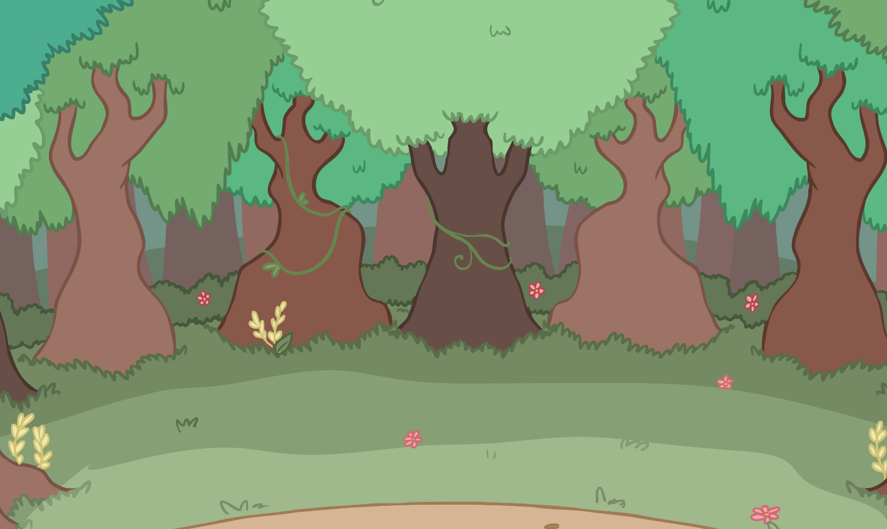
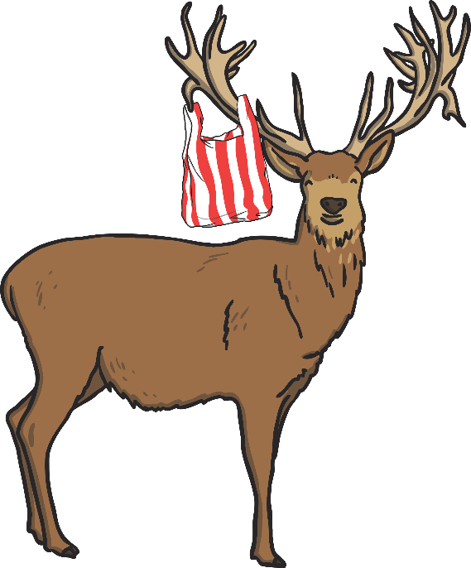
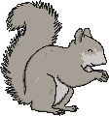

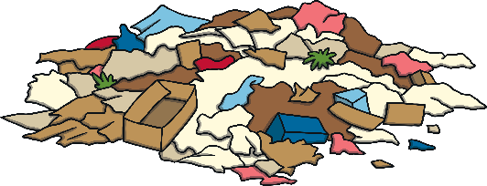
Always Put Your Litter in the Bin
Litter can harm wildlife and makes the environment look untidy. You can help to stop this from happening by putting your litter in the bin.

Slide 14

The Environment Needs You!
Choose one of these ways to help the environment and give it a try.
Together we can all make a difference.

