Slide 2
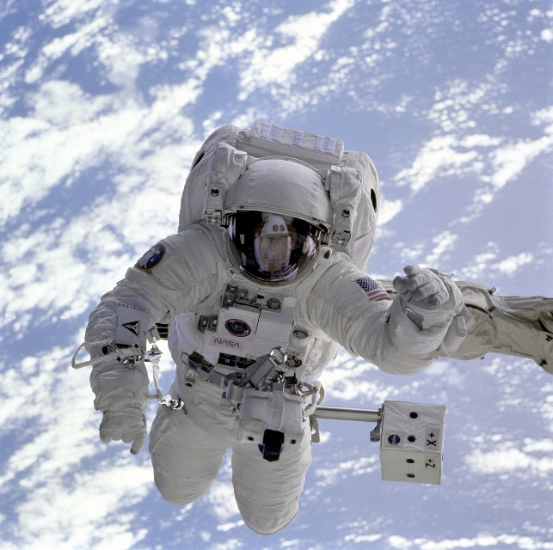
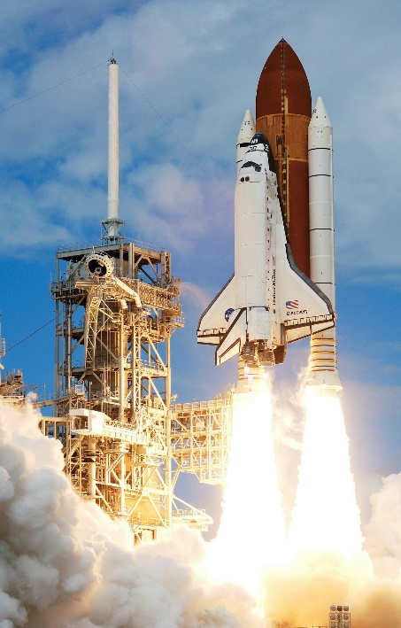
What is an Astronaut?
An astronaut is a person who is trained to travel into space.
To be an astronaut, you need to have lots of training and be very strong. Astronauts have to wear special spacesuits.
The spacesuits help them to breathe and protect them from very cold or very hot temperatures.

Slide 3
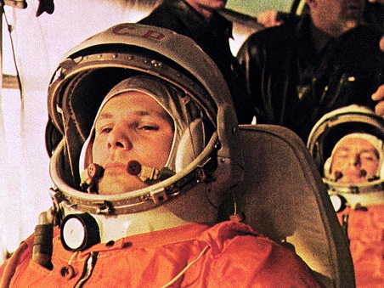
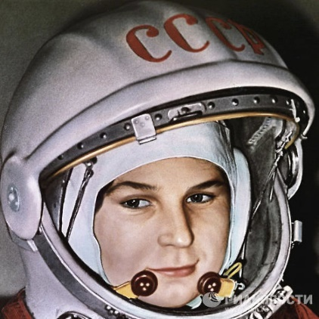
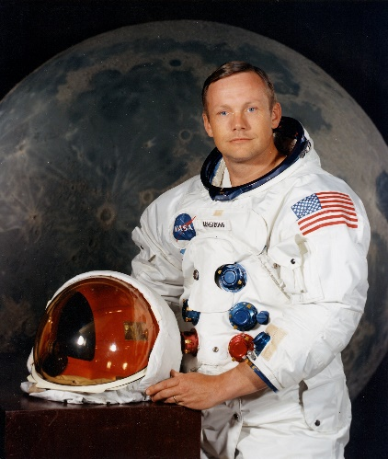
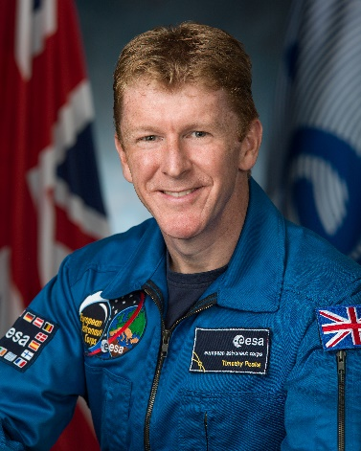
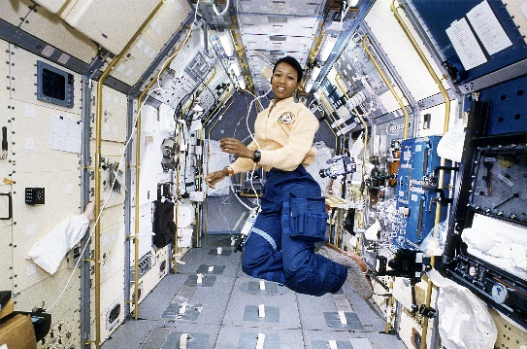
Famous Astronauts
Over 500 astronauts have gone on missions into space. Here are some astronauts that are famous for being significant in the history of space travel.
Yuri Gagarin
Valentina Tereshkova
Neil Armstrong
Tim
Peake
Mae Jemison

Slide 4

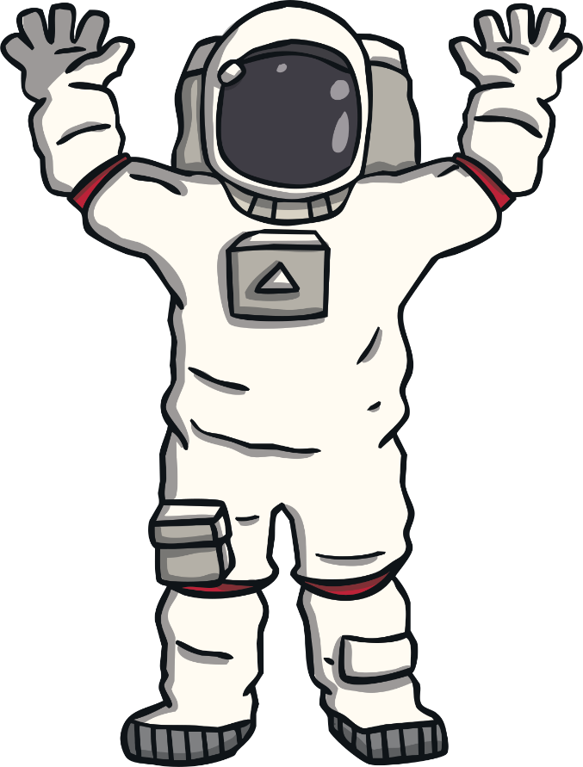
Yuri Gagarin
Yuri Gagarin is famous for being the first human to travel into outer space and orbit the earth.
Yuri Gagarin was born in 1934 in Russia. On the 12th April 1961, he was on board the spaceship Vostok 1, which took him into space. This made him the first human to ever go into space! It took him 108 minutes (that’s less than 2 hours) to orbit the Earth.
I said ‘Poyekhali’ when my spacecraft launched. That means ‘Let’s go!’ How do you think I felt?

Slide 5
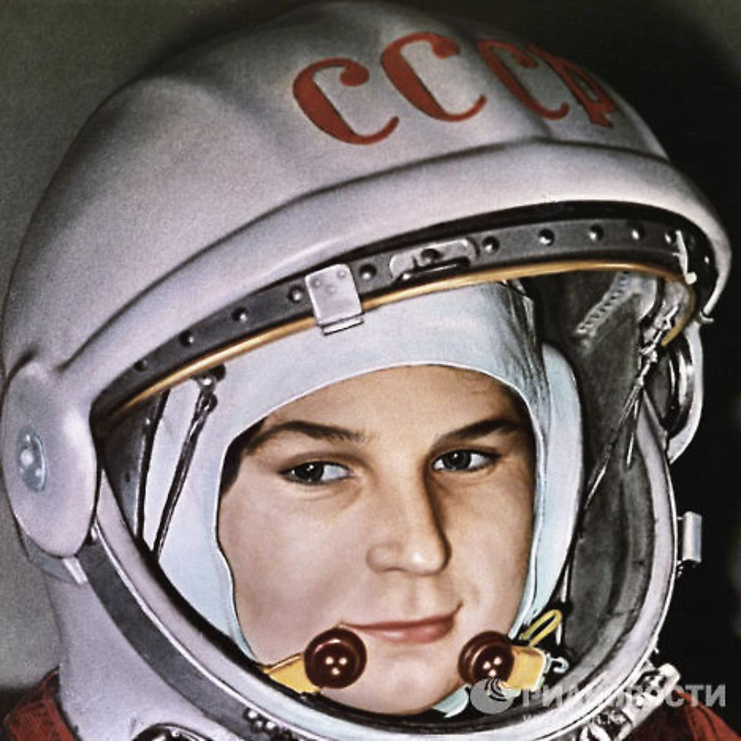

Valentina Tereshkova
Valentina Tereshkova is famous for being the first woman to travel into outer space and orbit the earth.
Valentina Tereshkova was born in Russia in 1937. In 1963, she travelled on her own on board the spacecraft Vostok 6.
Valentina was the first woman to travel into space. She orbited the Earth 48 times, which was a new world record! Valentina took many pictures of the Earth while she was in space.
On the journey back to Earth, there was a problem with the spacecraft and it nearly crashed! Valentina put all of her training into practice and was able to fix the problem.
Why do you think I took photographs while I was in space?

Slide 6


Neil Armstrong
Neil Armstrong is famous for being the first man to walk on the moon.
Neil Armstrong was born in 1930 in the United States of America.
On the 20th July 1969, Neil Armstrong landed on the Moon. He had travelled there on a spacecraft called Apollo 11 with two other astronauts - Michael Collins and Buzz Aldrin. Neil Armstrong was the first astronaut to leave the spacecraft and became the first man to walk on the Moon.
Buzz Aldrin also left the spacecraft on that trip.
They did important jobs, such as collect samples of moon rocks and complete experiments. They also planted an American flag. They landed back on Earth on the 24th July 1969.
When I first stepped onto the Moon, I said ‘That’s one small step for man, one giant leap for mankind.’ What do you think it means?

Slide 7

Mae Jemison
Mae Jemison is famous for being the first Black woman to travel into space.
Mae Jemison was born in 1956 in the United States of America.
In 1992, she became the first Black woman to travel to space. She was on board a spacecraft called Endeavour as a mission specialist.
She was in space for a total of 8 days and orbited the Earth 127 times. While she was on her mission, Mae carried out different scientific experiments.
What science experiment would you carry out if you went into space?

Slide 8

Major Tim Peake
Major Tim Peake is a British astronaut, famous for spending 186 days in space.
Major Tim Peake was a born England in 1972.
From December 2015, he went on a mission to the International Space Station and became the first official British astronaut to walk in space.
Major Tim Peake lived on the International Space Station for around six months. In this time, he performed many interesting scientific experiments.
He was often seen on videos and live calls, showing children and adults what he was doing!
I was in space for 186 days and lived on the International Space Station. Name one thing that you would take with you if you went to space for a long time.

Slide 9

Which Astronaut Has Inspired You the Most?
Talk to a partner and tell them which astronaut you thought was the most interesting. Can you explain why?
Yuri Gagarin
Valentina Tereshkova
Neil Armstrong
Tim
Peake
Mae Jemison

